Slide 1
Predicting the thermodynamic effect of mutations on a genome-wide scale
Alexey Strokach

Slide 2
Overview
Introduction
Rise in genome sequencing
Difficulty in interpreting discovered variants
ELASPIC (Berliner et al. 2014)
Implementation
Domain definitions
Database backend
ELASPIC pipeline and CLI
Precalculating data
ELASPIC REST API
Results
Grid-search (to find a good set of parameters)
Feature elimination
Discussion
What have we learned?
Future directions
Future directions
Better features / model
More training data

Slide 3
Introduction

Slide 4
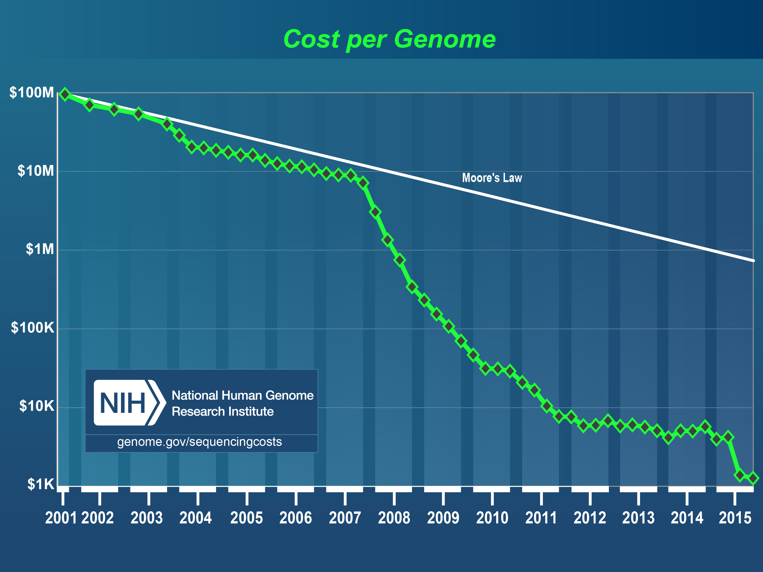
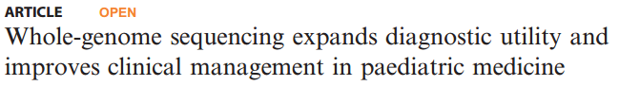
Introduction - Rise in genome sequening
Cost of genome sequencing has fallen dramatically.
Interpreting genomic variants to yield meaningful and actionable results remains a challenge.
https://www.genome.gov/27541954/dna-sequencing-costs-data/

Slide 5
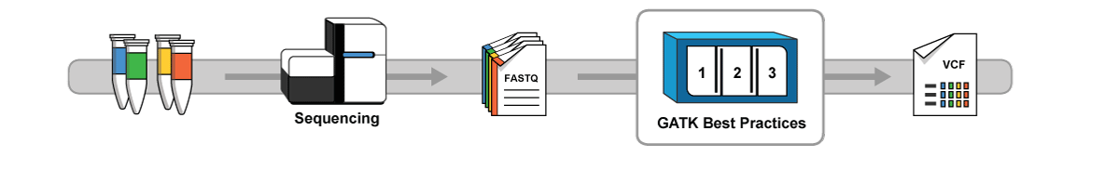
Introduction - Variant calling / scoring
Variant calling
https://software.broadinstitute.org/gatk/
Notes:
We are all going to hell in a bread basket.

Slide 6
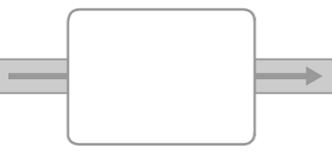






Introduction - Variant calling / scoring
Variant calling
https://software.broadinstitute.org/gatk/
Variant scoring
# chr position ref alt...
SIFT
Provean
GERP++
etc...
dbNSFP
Notes:
We are all going to hell in a bread basket.

Slide 7
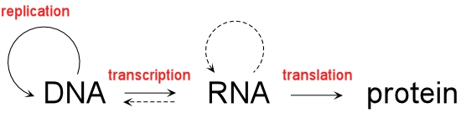
Introduction - Variant analysis
Notes:
All happy families are alike; each unhappy family is unhappy in its own way. -> "In what way is the great big family of proteins unhappy in each person, and what can we do make them happy?"

Slide 8

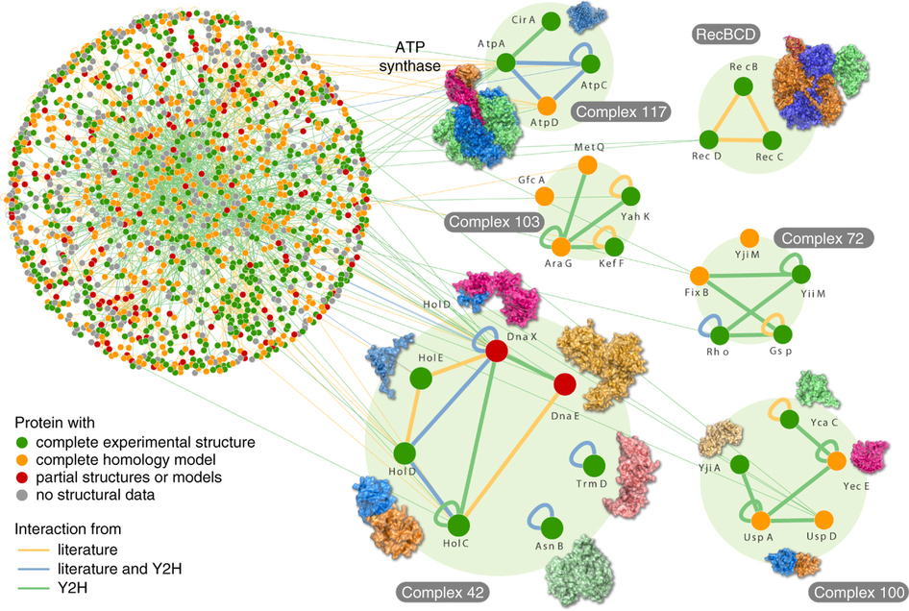

Introduction - Variant analysis
Variant interpretation
Rajagopala S. et al., Nature Biotech., 2014.
Notes:
All happy families are alike; each unhappy family is unhappy in its own way. -> "In what way is the great big family of proteins unhappy in each person, and what can we do make them happy?"

Slide 9
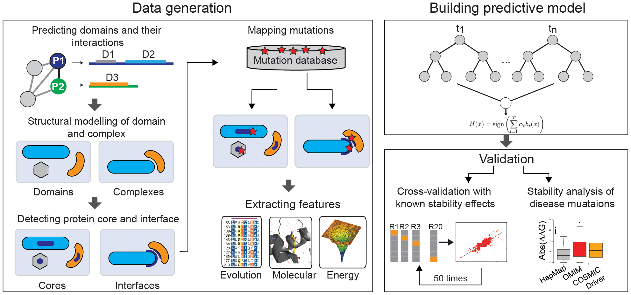
Introduction - Variant analysis
ELASPIC (Berliner et al. 2014)

Slide 10
Introduction - Goals
Goals
Extend ELASPIC to work on a genome-wide scale
Profs for domain definitions
Use programs that work for most sequences / structures
Implement ELASPIC as a back-end to a webserver
Demonstrate the usefullness of ELASPIC in providing meaningful and actionable information about mutations.

Slide 11
Implementation

Slide 12
Implementation
Domain definitions
Profs (Andres Felipe Giraldo-Forero)
Domain-domain interactions
Database backend
ELASPIC pipeline + CLI interface
Precalculate Provean, homology models, and many mutations
Webservice for submitting and monitoring jobs

Slide 13
Implementation - Domain definitions

Slide 14
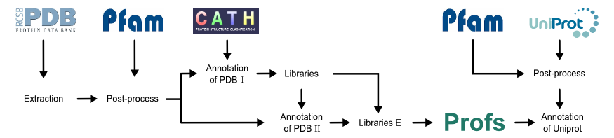
Implementation - Domain definitions
(3)
(1)
(2)
(4)
(5)
(6)
Andres Felipe Giraldo Forero

Slide 15
Implementation - Domain definitions
(3)
(1)
(2)
(4)
(5)
(6)
Pfam
Pfam supradomains
Final Profs BLAST libraries
Profs
Profs Clan A
Profs Clan C
…
…
Profs Clan B
Profs Clan D
…
…
64+ million Pfam domains
57+ million Pfam supradomains
42+ million (74%) Profs domains
Notes:
Pfam domain definitions from SIMAP.

Slide 16
Implementation - Domain interactions
(3)
(1)
(2)
(4)
(5)
(6)
Profs
Profs
Final Profs BLAST libraries
Profs Domain Pairs
PPI
Profs Clan A
Profs Clan C
Profs Clan B
Profs Clan D
…
…
…
…
…
42+ million Profs domains
42+ million Profs domains
466,010 domain pairs with structural templates
9+ million possible domain-domain combinations (mostly human)

Slide 17

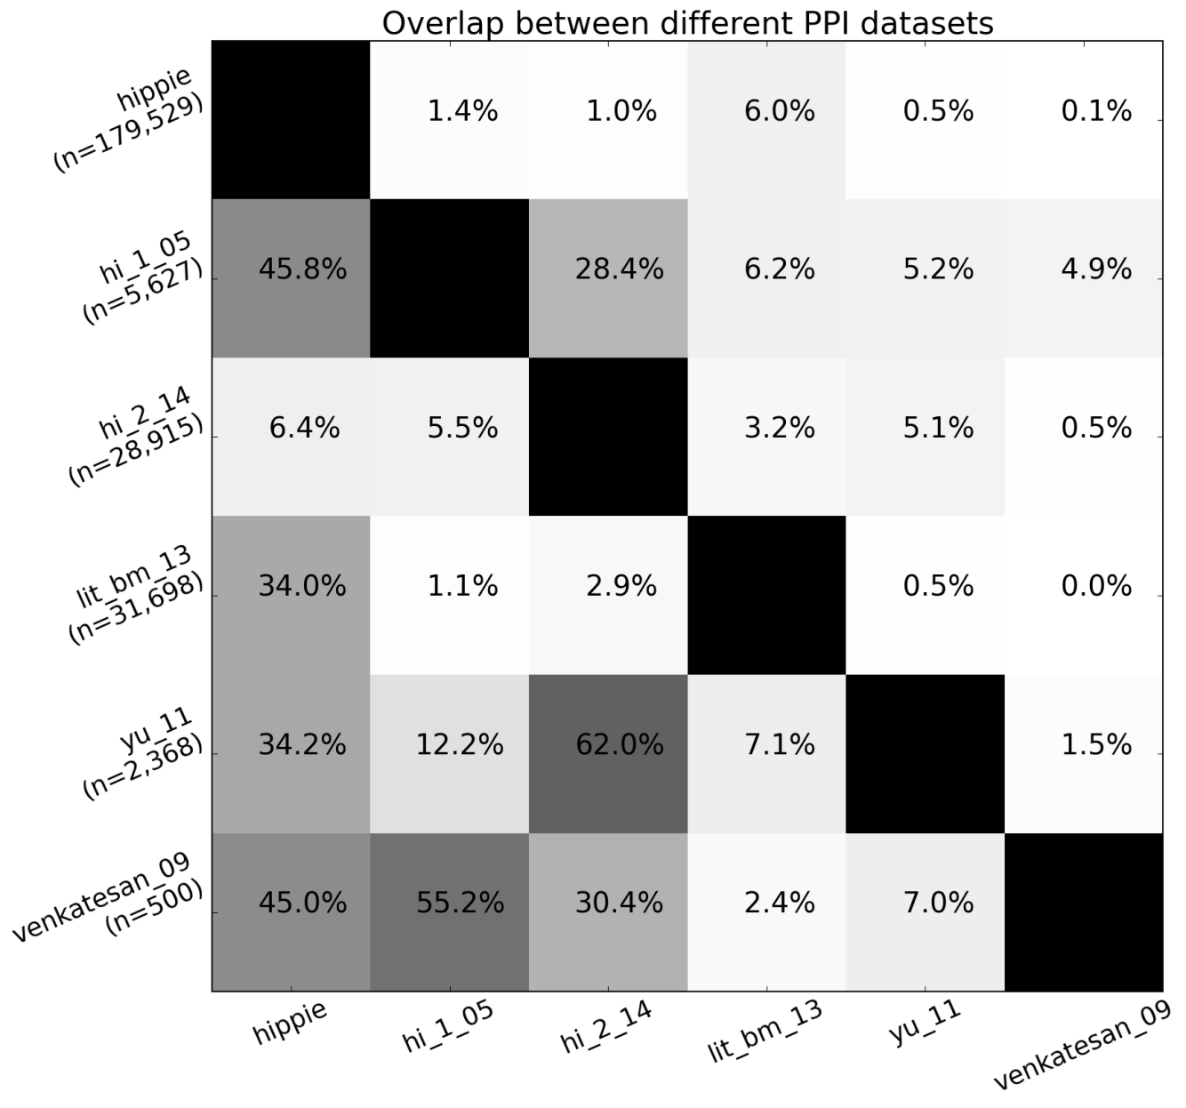
Implementation - Protein interactions
HIPPIE: Integrating Protein Interaction Networks with Experiment Based Quality Scores, Schaefer et al., PLOS ONE, 2012
A Human Protein-Protein Interaction Network: A Resource for Annotating the Proteome, Stelzl et al., Cell, 2005
A proteome-scale map of the human interactome network, Rolland et al., Cell, 2014

Slide 18
Implementation - Database backend

Slide 19
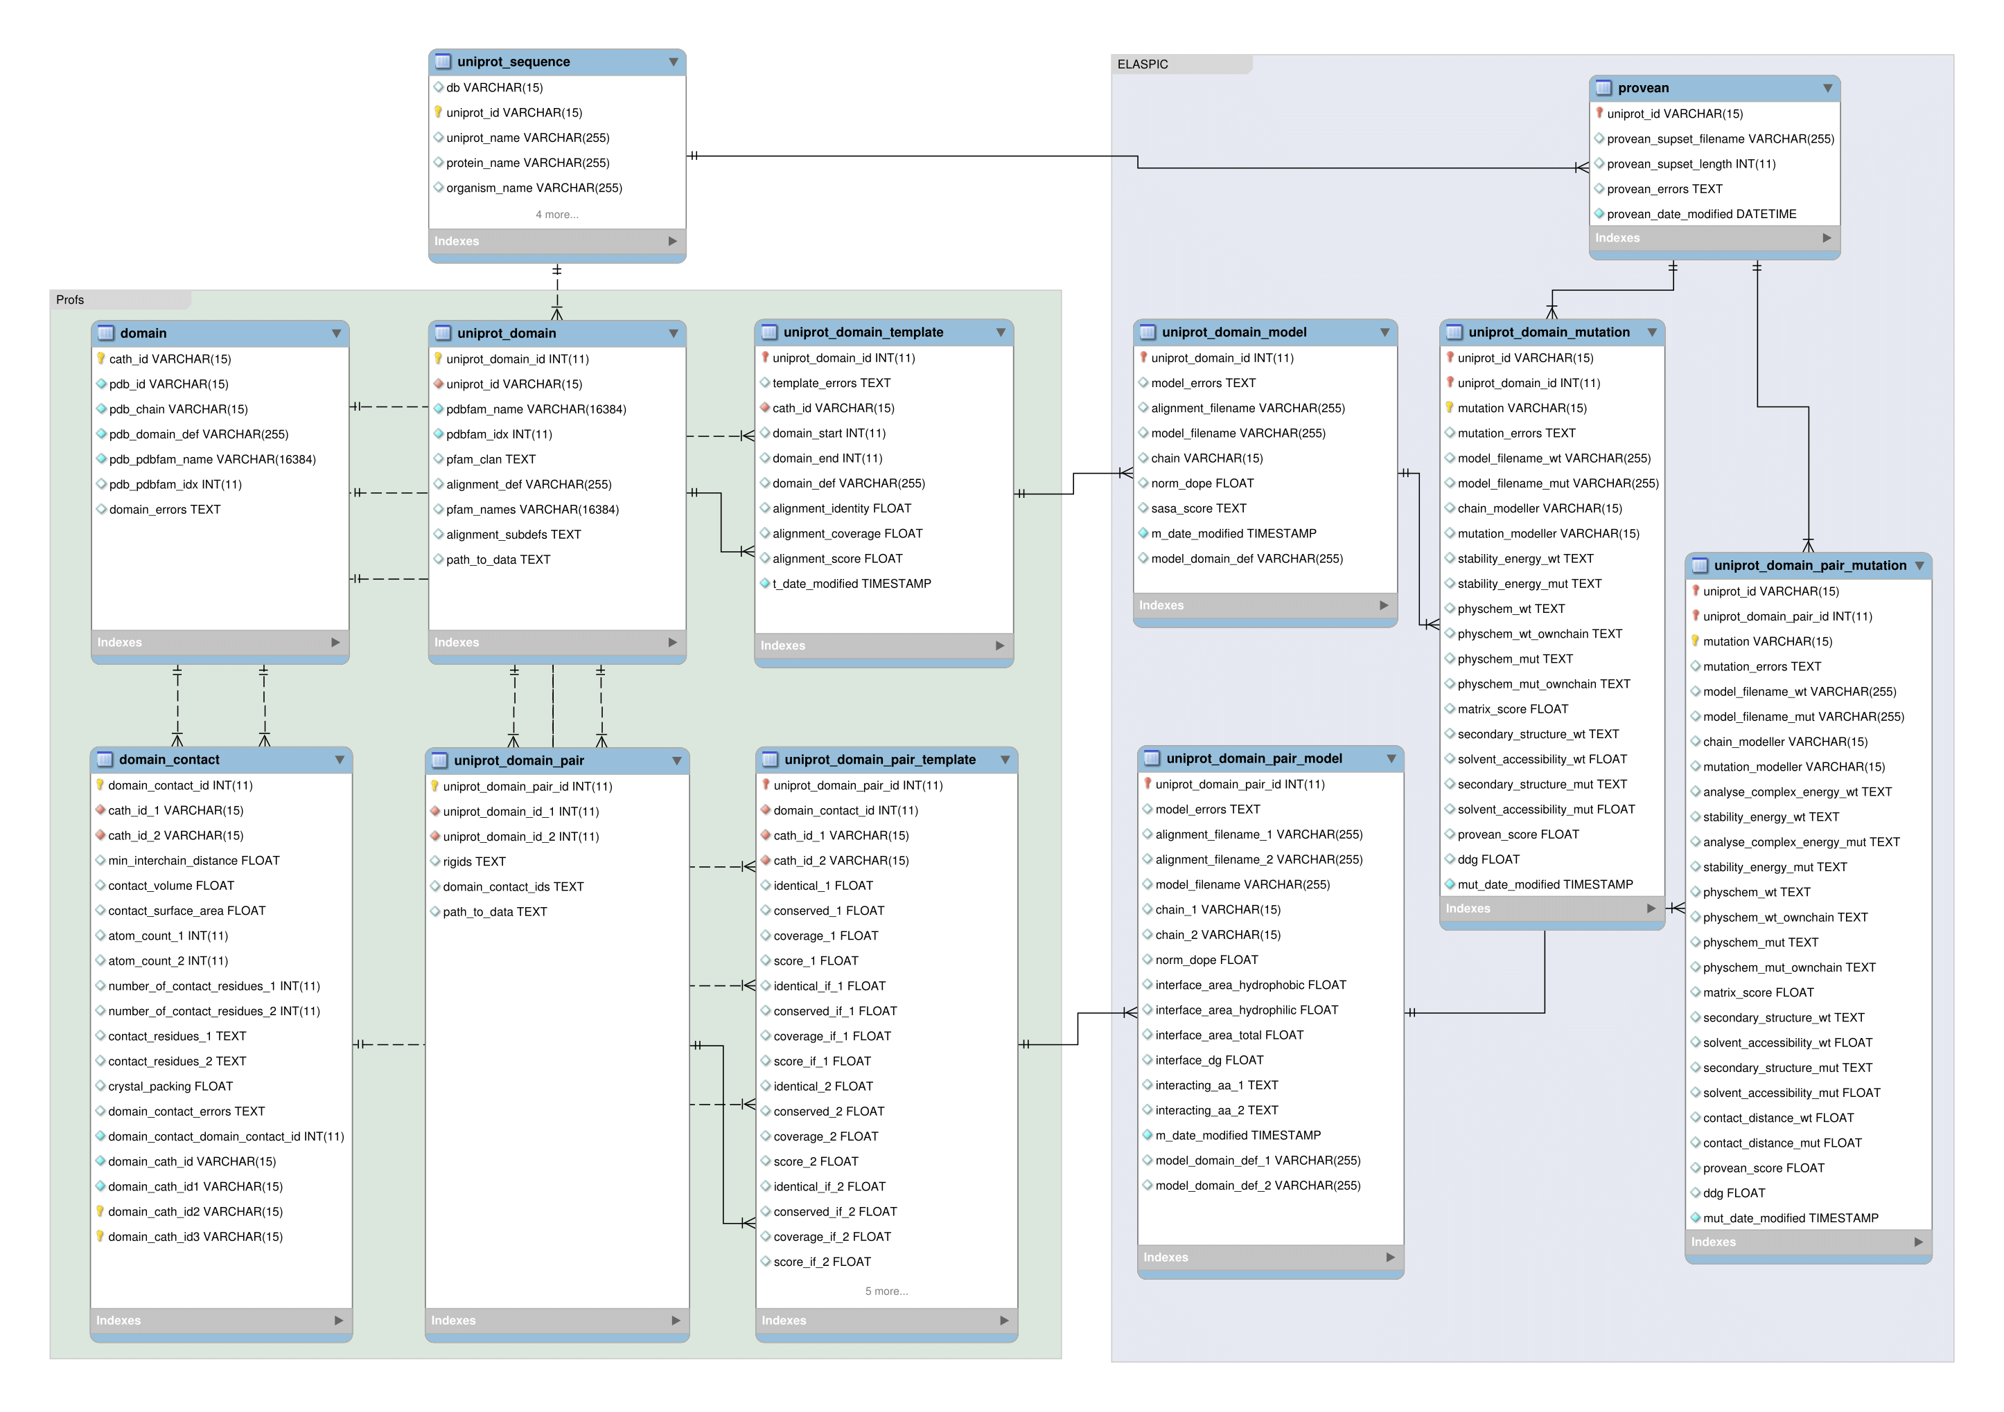
Implementation - Database backend

Slide 20
Implementation - ELASPIC pipeline and CLI

Slide 21
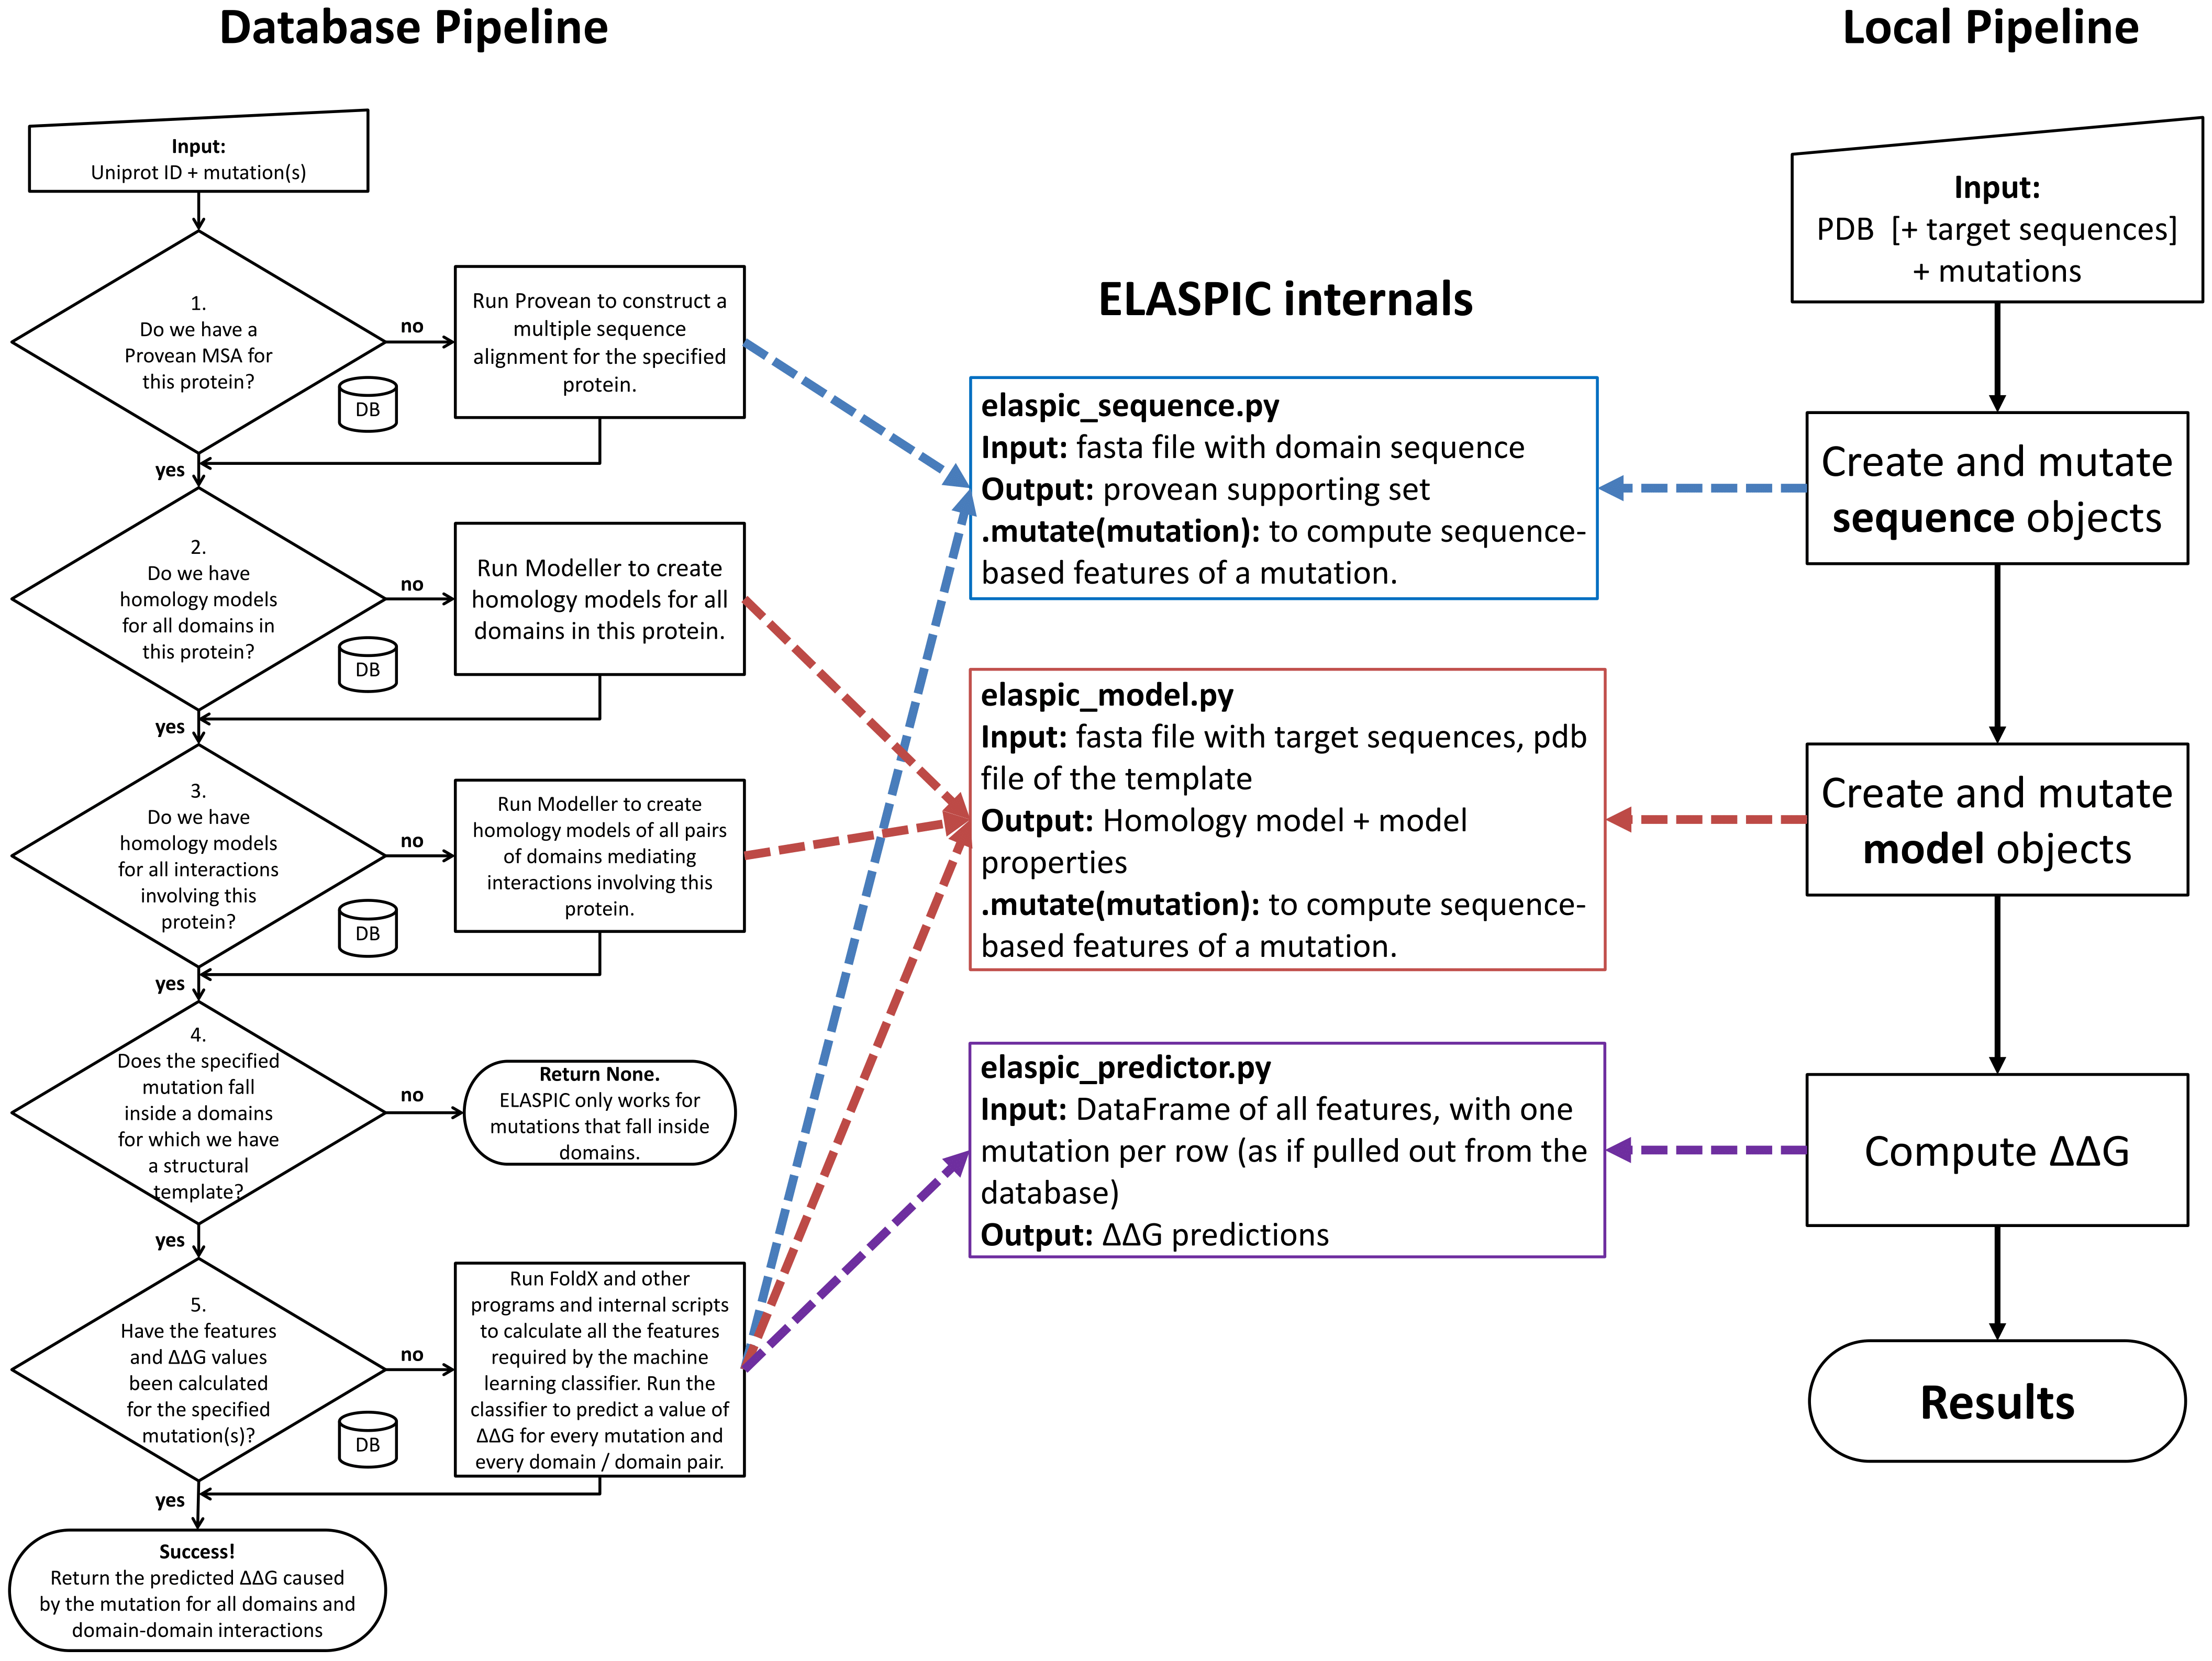
Implementation - ELASPIC pipeline and CLI

Slide 22
Implementation - Precalculated data

Slide 23
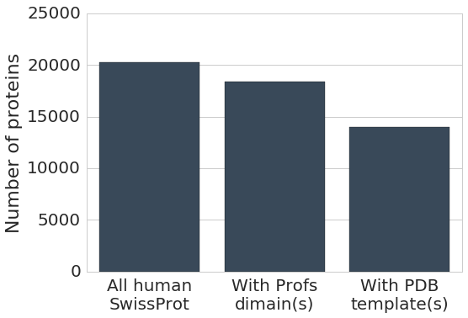
Implementation - Precalculated data
Found structural templates

Slide 24
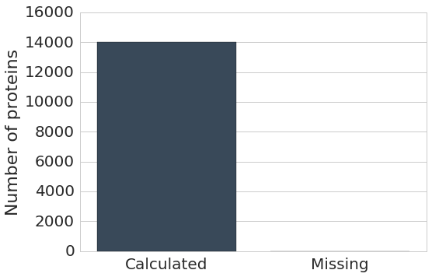
Implementation - Precalculated data
Precalculated Provean

Slide 25
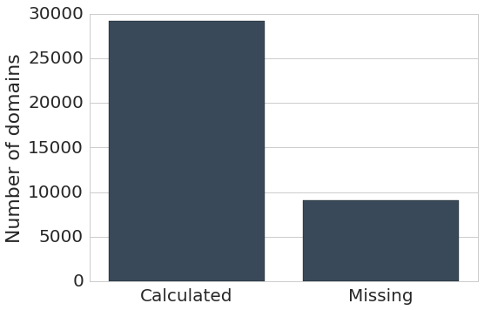
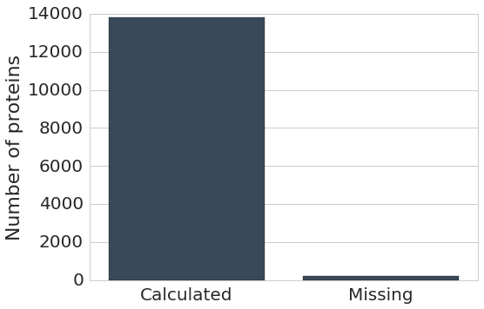
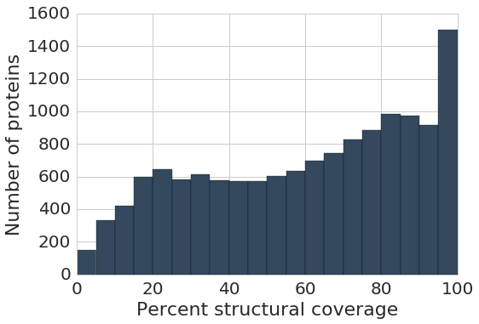
Implementation - Precalculated data
Precalculated domains
Precalculated at least one model
Structural coverage for proteins with at least one model

Slide 26
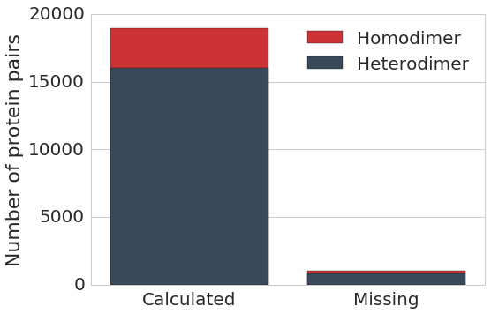
Implementation - Precalculated data
Precalculated interfaces (excluding splice variants)

Slide 27
Implementation - Precalculated data
991,533 core mutations
593,106 interface mutations
Includes mutations from popular databases such as UniProt (humsavar.txt), ClinVar, COSMIC.

Slide 28
Implementation - Webservice
Notes:
If you are familiar with Node.JS, this will not be new. This is how Node does everything.

Slide 29
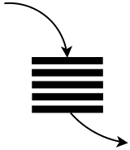


Implementation - Webservice
Asyncronous web server for submitting and monitoring ELASPIC jobs.
Can have thousands of mutations, so having a thread monitoring each mutation would not be a good design.
Need to update job status to "done" when all mutations are done, in order to send the "Job complete" email.
No blocking calls!
Submit and monitor Provean jobs.
Requests, etc.
Event loop
Job status
Submit and monitor homology modelling jobs.
Submit and monitor mutation jobs.
Python 3.5 + aiohttp
Notes:
If you are familiar with Node.JS, this will not be new. This is how Node does everything.

Slide 30
Results

Slide 31
Results
Core mutation predictor
Retrain core predictor
Feature elimination to thrown away unimportant features
Validate on an independent, non-overlapping datataset
Interface mutation predictor
Retrain core predictor
Feature elimination to thrown away unimportant features
Validate on an independent, non-overlapping datataset

Slide 32
Results - Datasets
Training:
Protherm: Database of changes in the Gibbs free energy of protein folding caused by mutations.
Skempi: Database of changes in the Gibbs free energy of protein folding caused by mutations.
Training / Validation:
Taipale: Chaperone interaction assay measuring protein stability.
Taipale PPI: "Yiest two hybrid studies measuring the effect of mutations on the presence / abscence of interactions."
Taipale GPCA: "Gaussia princeps luciferase protein complementation assay" measuring the effect of mutations on protein affinity.
Test:
Humsavar: Disease-causing mutations vs. polymorphisms. Mostly OMIM, old ClinVar, old COSMIC.
Clinvar: Disease-causing mutations with a weaker inheritence link than OMIM.
COSMIC: Mutations found in cancers. Use high-confidence FATHMM predictions.
SUMO Ligase: Mutations affecting the activity of SUMO ligase, measured using a cell viability assey.
AB-Bind: Antibody affinity maturation experiments.
Benedix et al.: Alanine scanning of the TEM1-BLIP (β-lactamase - β-lactamase-inhibitor) complex.

Slide 33
Results - Core predictor

Slide 34
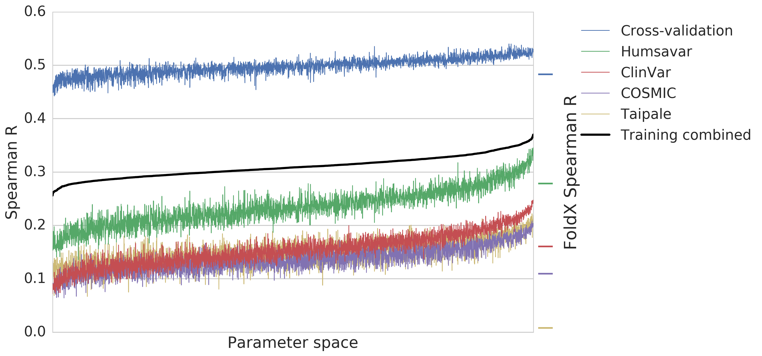
Results - Core parameter search
Training combined = 3 × Cross-validation +
1 × (Humsavar + ClinVar + COSMIC) +
1 × Taipale

Slide 35
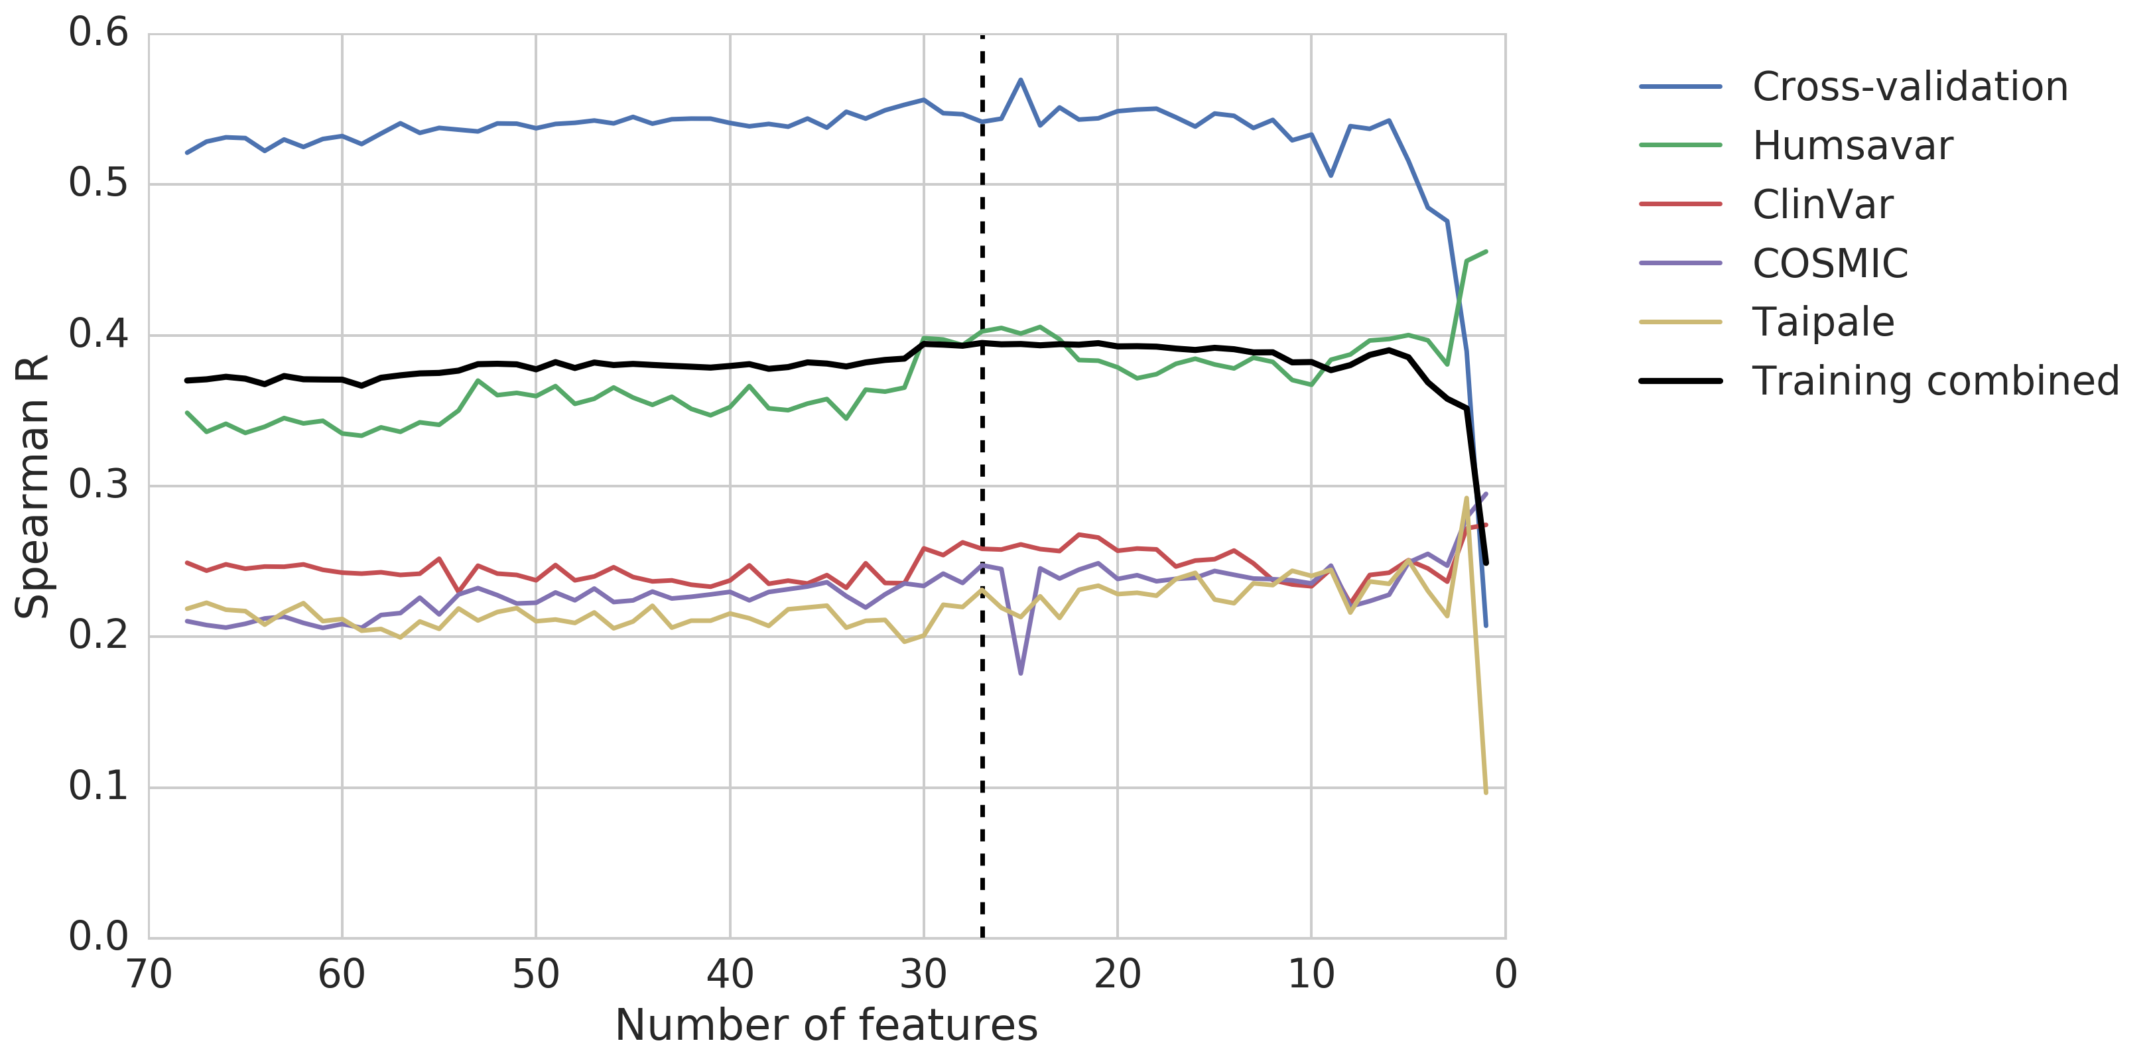
Results - Core feature elimination
Training combined = 3 × Cross-validation +
1 × (Humsavar + ClinVar + COSMIC) +
1 × Taipale

Slide 36
Results - Core important features
Feature name | Feature description | * / **
alignment_coverage | Alignment quality
alignment_identity | Alignment quality
alignment_score | Alignment quality
backbone_hbond_change | FoldX
backbone_hbond_wt | FoldX
cis_bond_wt | FoldX
disulfide_wt | FoldX
electrostatic_kon_change | FoldX
electrostatics_change | FoldX | *
entropy_mainchain_change | FoldX
helix_dipole_wt | FoldX
matrix_score | Sequence conservation
pcv_hbond_change | Physico-chemical features
pcv_hbond_self_change | Physico-chemical features
pcv_salt_equal_change | Physico-chemical features
pcv_salt_equal_self_wt | Physico-chemical features
pcv_salt_equal_wt | Physico-chemical features
pcv_salt_opposite_change | Physico-chemical features
pcv_vdw_self_change | Physico-chemical features
provean_score | Sequence conservation | **
sloop_entropy_wt | FoldX
solvation_hydrophobic_change | FoldX | *
solvation_polar_change | FoldX | **
solvent_accessibility_wt | FoldX | *
torsional_clash_change | FoldX
van_der_waals_clashes_change | FoldX | *
water_bridge_wt | FoldX
* top 6 ** top 6 interface

Slide 37
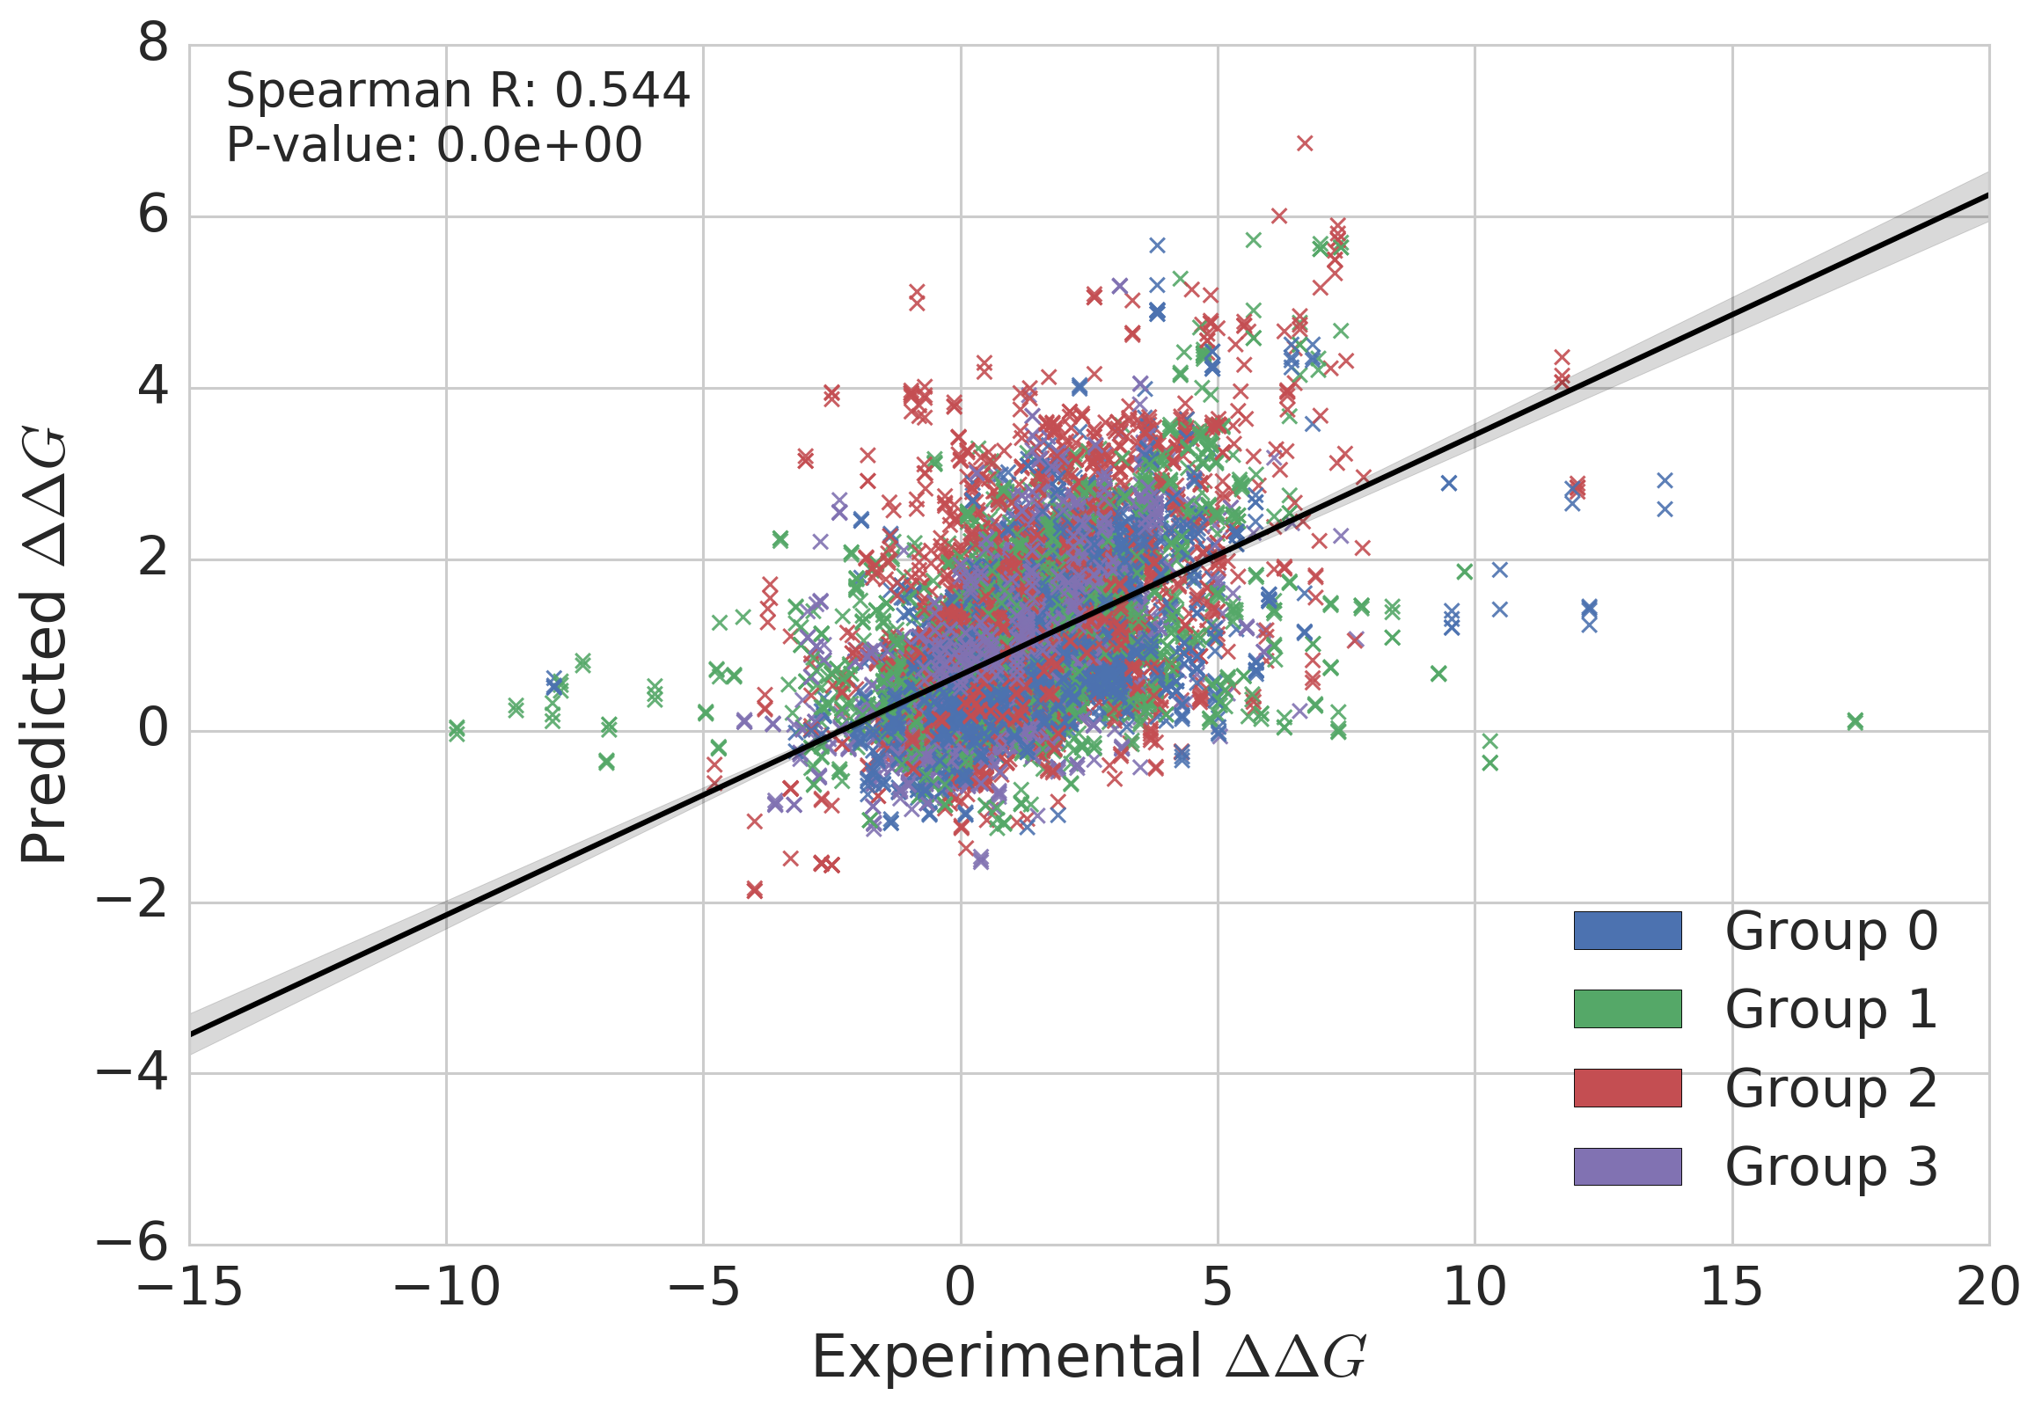
Results - Core cross-validation

Slide 38
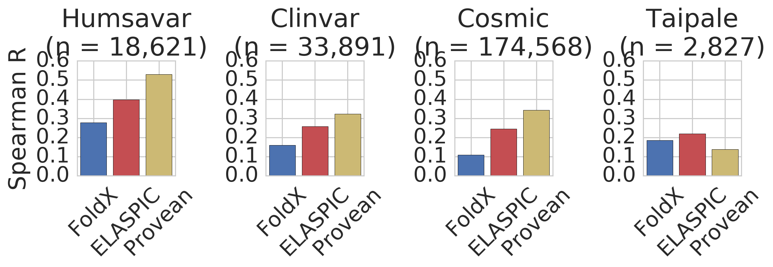
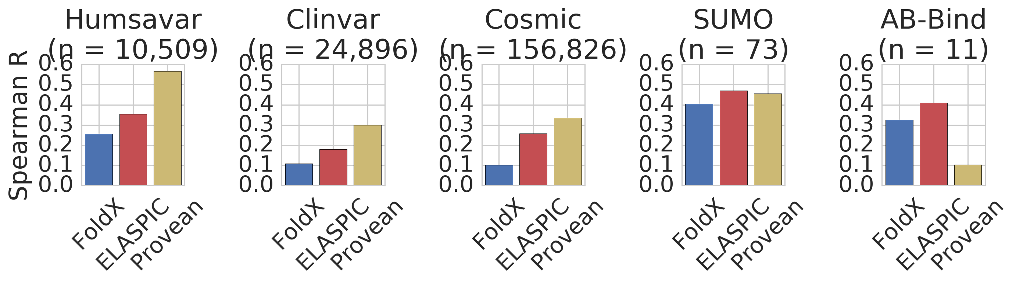
Results - Core validation/test performance

Slide 39
Results - Interface predictor

Slide 40
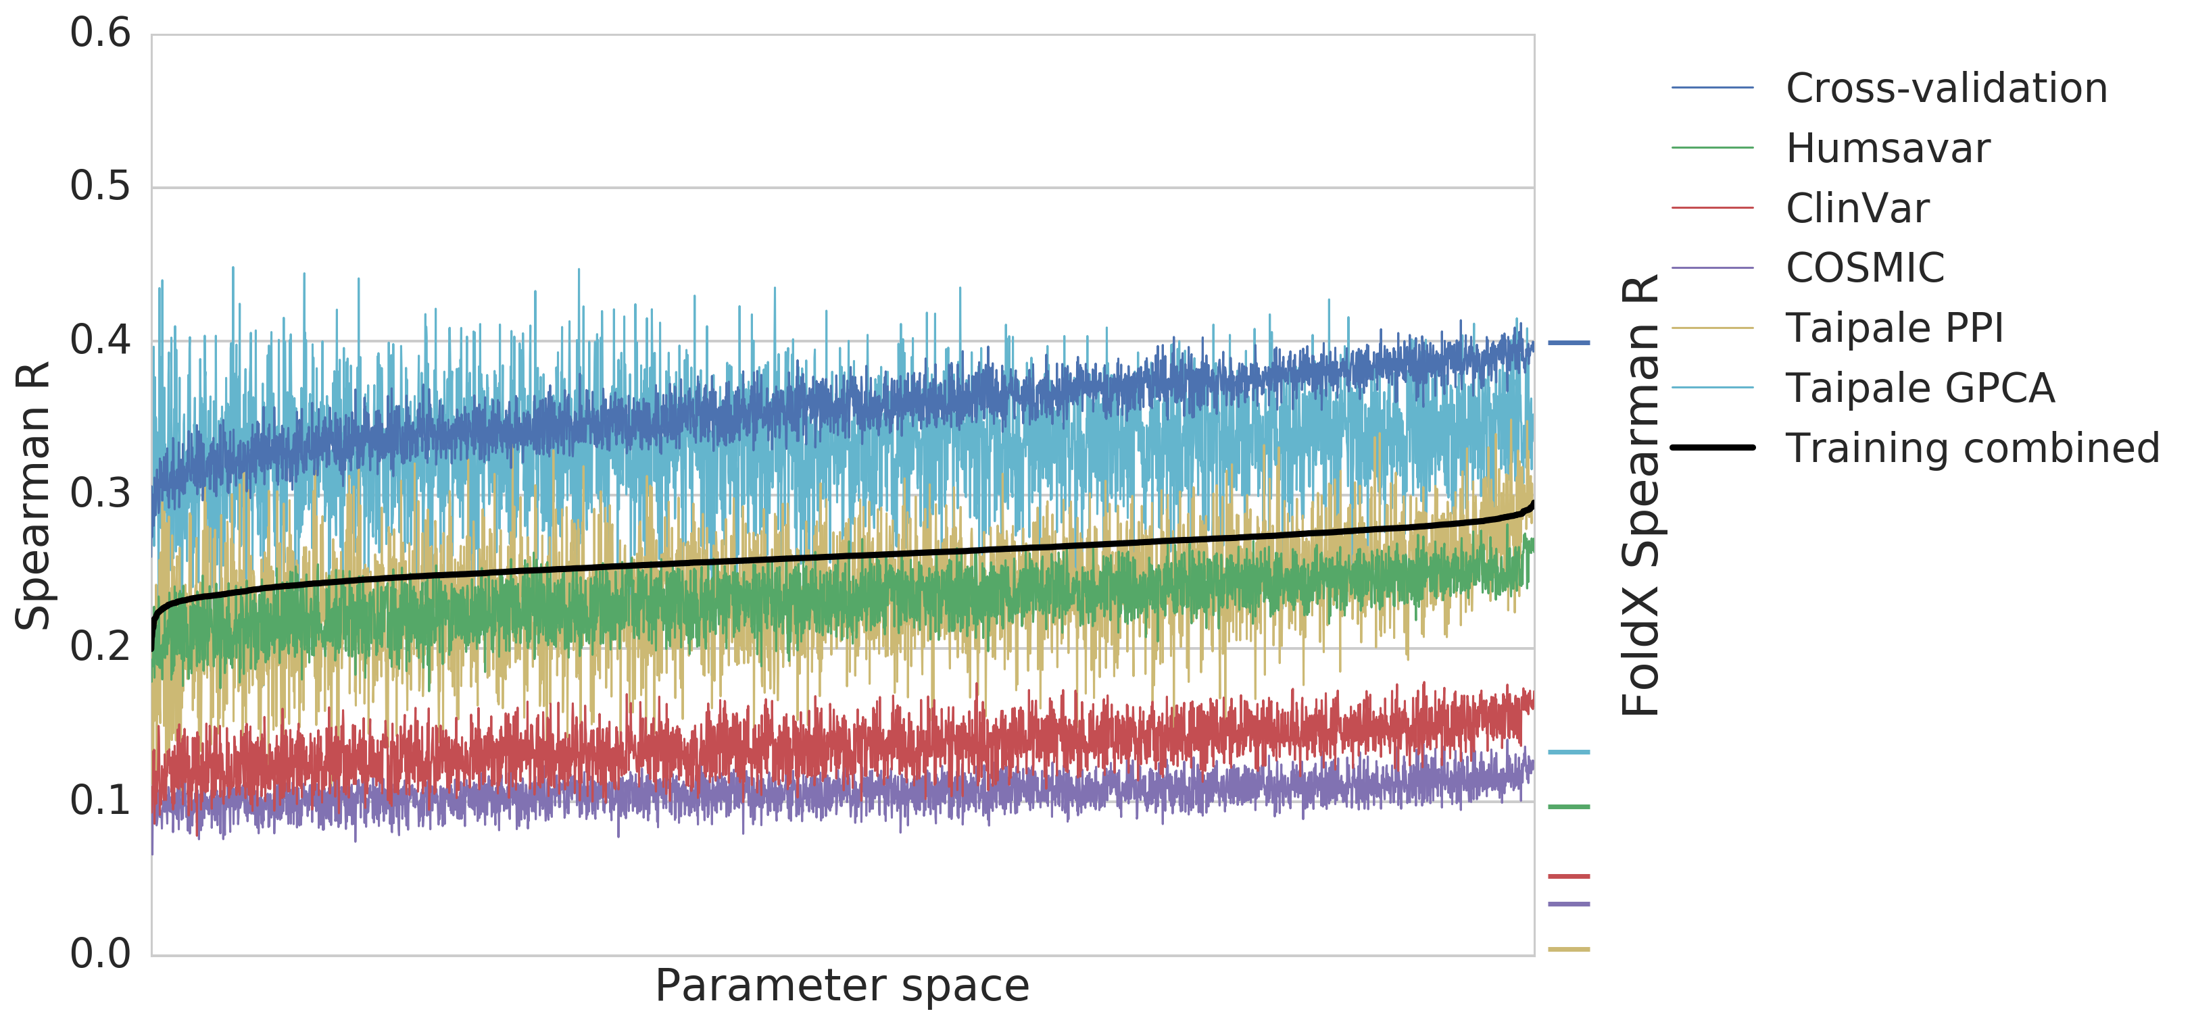
Results - Interface parameter search
Training combined = 3 × Cross-validation +
1 × (Humsavar + ClinVar + COSMIC) +
1/4 × (Taipale PPI + Taipale GPCA)

Slide 41
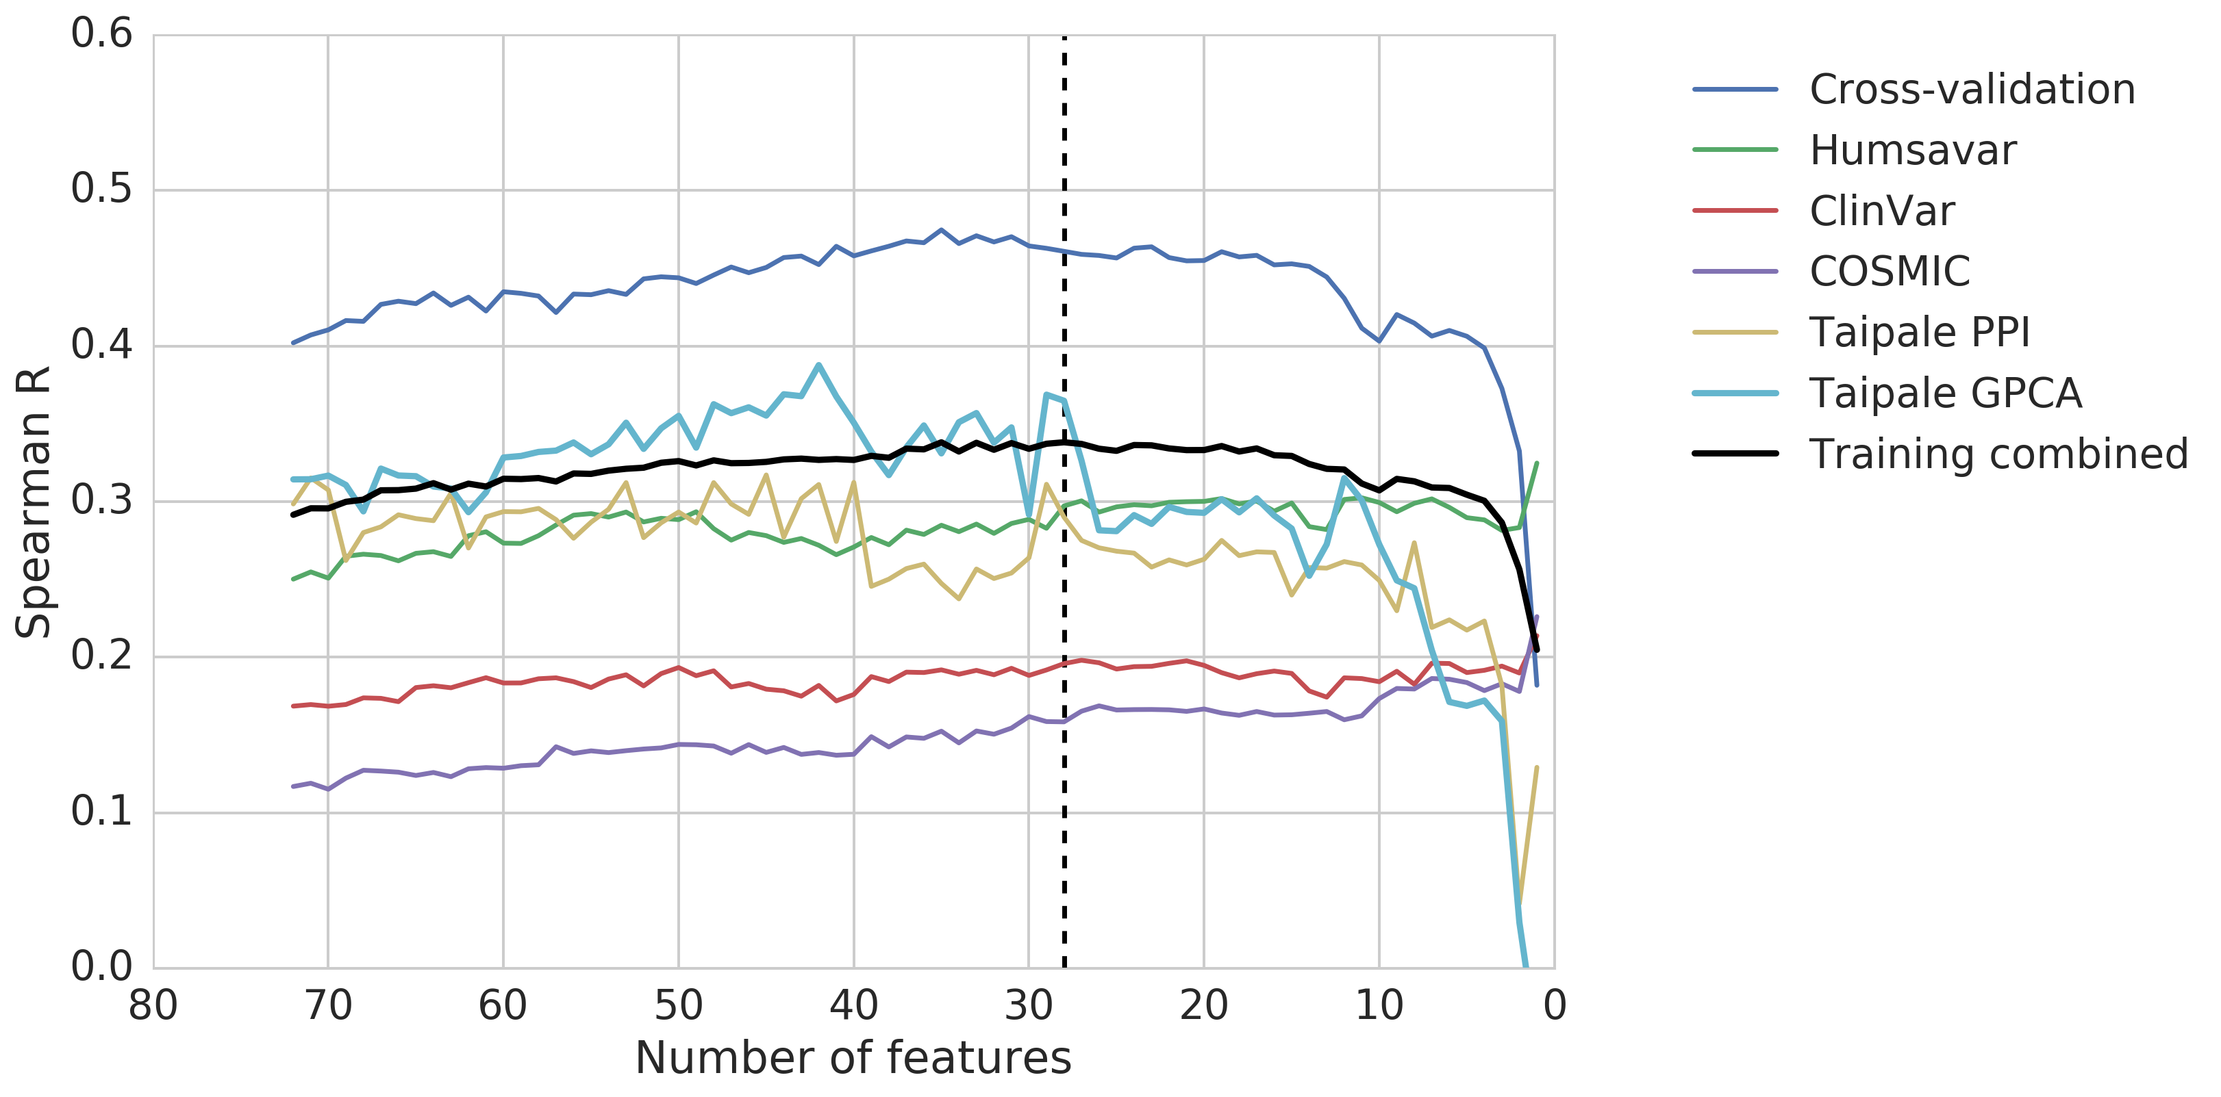
Results - Interface feature elimination
Training combined = 3 × Cross-validation +
1 × (Humsavar + ClinVar + COSMIC) +
1/4 × (Taipale PPI + Taipale GPCA)

Slide 42
Results - Interface important features
Feature name | Feature description | * / **
alignment_score | Alignment quality
backbone_clash_change | FoldX
backbone_clash_wt | FoldX
backbone_hbond_change | FoldX
cis_bond_wt | FoldX
electrostatic_kon_wt | FoldX
energy_ionisation_wt | FoldX
entropy_complex_change | FoldX
entropy_sidechain_change | FoldX | *
intraclashes_energy_2_change | FoldX
partial_covalent_bonds_wt | FoldX | *
pcv_hbond_self_change | Physico-chemical features
pcv_hbond_wt | Physico-chemical features
pcv_salt_equal_self_change | Physico-chemical features
pcv_salt_equal_wt | Physico-chemical features
pcv_salt_opposite_change | Physico-chemical features
pcv_salt_opposite_self_change | Physico-chemical features
pcv_salt_opposite_self_wt | Physico-chemical features
pcv_vdw_self_change | Physico-chemical features
pcv_vdw_self_wt | Physico-chemical features | *
pcv_vdw_wt | Physico-chemical features | *
provean_score | Sequence conservation | **
sloop_entropy_change | FoldX
solvation_hydrophobic_change | FoldX
solvation_polar_change | FoldX | **
solvation_polar_wt | FoldX
torsional_clash_change | FoldX
water_bridge_change | FoldX
* top 6 ** top 6 core

Slide 43
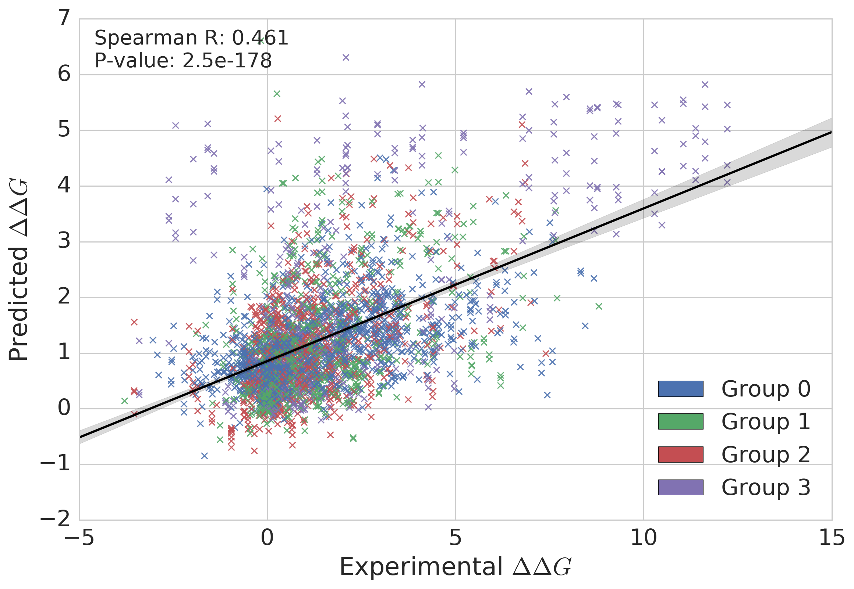
Results - Interface cross-validation

Slide 44
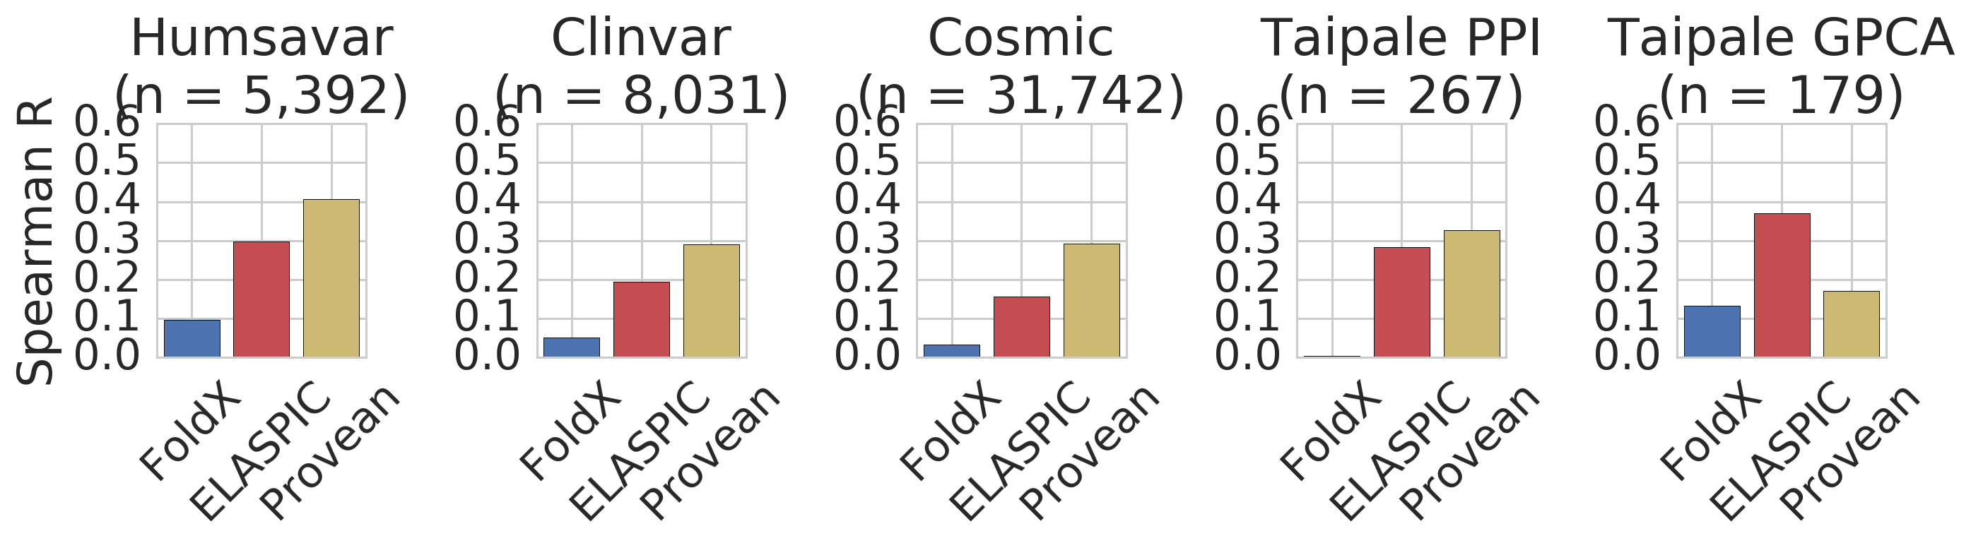
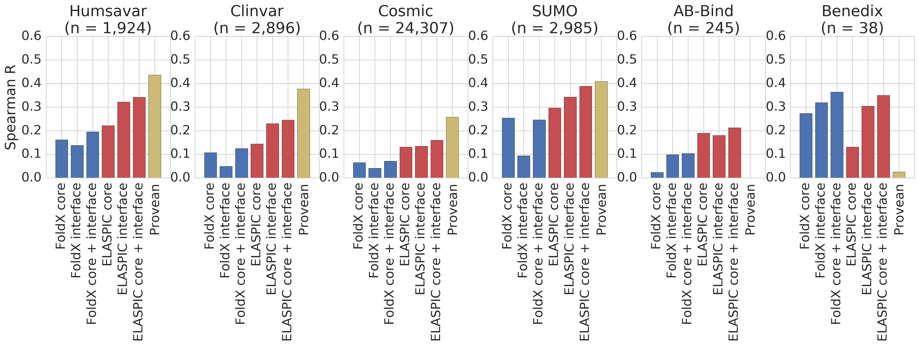
Results - Interface validation/test performance

Slide 45
Discussion

Slide 46
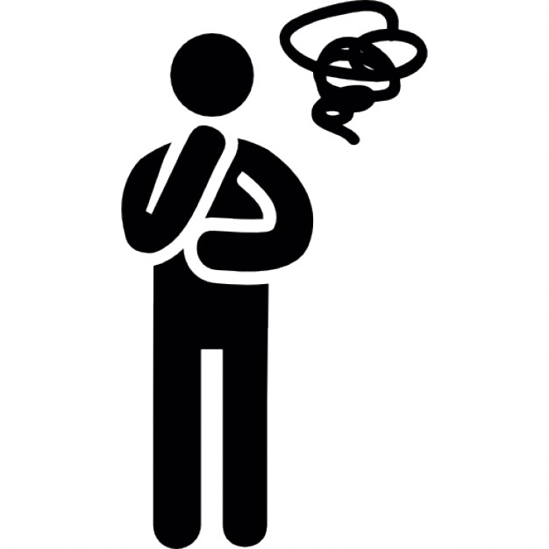
Discussion
"∆∆G' is a worse predictor of mutation deleteriousness than conservation score.
This holds true even for interface mutations.
No evidence that "edgetic' mutations are more likely to be disease causing.
Most features are not very informative.
The only dataset where we do better than Provean is AB-Bind.
...
Need to look at deleterious mutations with a small ∆∆G and benign mutations with a high ∆∆G...

Slide 47
Discussion
Don't think predicting ∆∆G on a genome-wide scale is very useful...
...until we start thinking about building a thermodynamic model of the cell?
Some features could be useful:
SASA scores
Whether or not the residue is involved in an interaction
The only dataset where we do better than Provean is AB-Bind...
Maybe there is a way to "repurpose' the project for protein design?
See future directions...

Slide 48
Future directions

Slide 49
Future directions
Better features
More training data
ELASPIC v2.0

Slide 50
Future directions - Better features

Slide 51
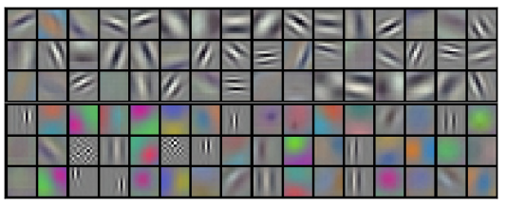
Future directions - Better features
Lessons from convolutional neural networks:
Pretrain a deep ConvNet on a large dataset (e.g. ImageNet)
Use the first layer(s) in other applications with a smaller training set

Slide 52
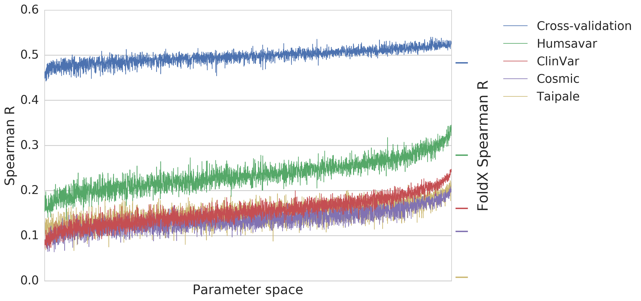
Future directions - Better features
Use the same approach for ELASPIC:
Feature extraction using a Gradient Boosting Classifier (GBC) trained to predict deleteriousness scores
With provean: learn features with better mixing of sequence and structural information?
Without provean: learn features approximating backbone wiggle in the absence of sequence information.
Logistic regression using trained GBC features as input to predict mutation.
At least good performance telling you which mutations are bad...

Slide 53
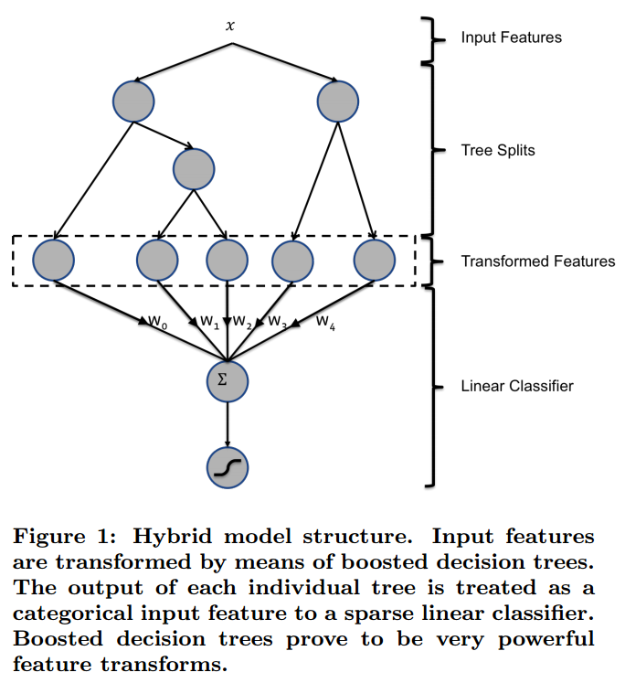
Future directions - Better features
Train to predict the deleteriousness of mutations.
Train to predict ∆∆G.
Practical Lessons from Predicting Clicks on Ads at Facebook. He Xinran et al. International Workshop on Data Mining for Online Advertising (ADKDD). August 24, 2014.

Slide 54
Future directions - More data

Slide 55
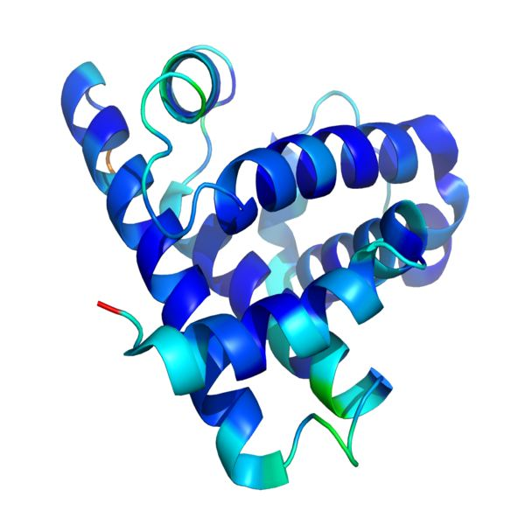
Future directions - More data
Include multi-residue mutations
Bootstrap ∆∆G scores of constituent mutations by normalizing the ∆∆G given by ELASIC by the divergence between the ELASPIC predicted and experimental values.
Normalize (divide by 2 in this case) and add to the ELASPIC training data.
1st: 3.3 kcal / mol
2nd: 2.2 kcal / mol
2nd: 1.1 kcal / mol
Actual: 3.3 kcal / mol
Total: 6.6 kcal / mol

Slide 56
Future directions - Even more data
Include other datasets following the same "bootstrap" procedure.
For the core predictor, create a dataset of mutations to thermophilic organism coming from nearest ancesstor.
For the interface predictor, convert phage-display drop-off scores to ∆∆G and add to ELASPIC training set (maybe need to log-transform or perform other correctionns).

Slide 57

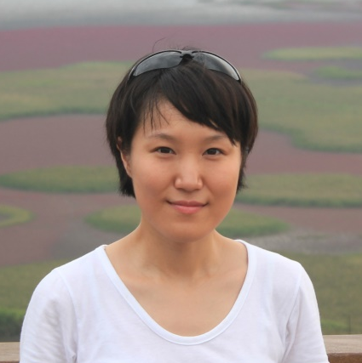
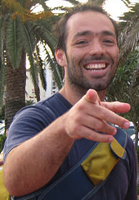
Acknowledgements
Supervisor:
Philip M. Kim
Members of kimlab:
Recep Colak
Carles Corbi
Michael Garton
Clare Juhyun Jeon
Mark Sun
Joan Teyra
Project students:
Niklas Berliner
Andres Felipe Giraldo Forero
Hanif Jetha
Sebastian Garcia Lopez
Daniel Witvliet
Clare Juhyun Jeon
Joan Teyra

Slide 58
Overview
Goal: Predict the effect of mutations on protein stability and protein interaction affinity on a genome-wide scale.
Rajagopala S. et al., Nature Biotech., 2014
Profs
Accurate domain definitions for all proteins in a given organism.
Structural templates for domains and domain-domain interactions.
ELASPIC
Homology models of domains and domain interactions.
A classifier trained to predict the effect of mutations on protein stability and protein interaction affinity.

Slide 59
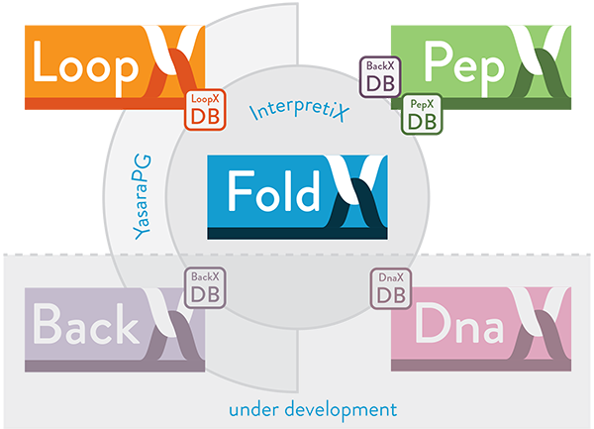
Future directions - ELASPIC v2.0 [v0.2.0 :)]
ELASPIC "namespace" package
core
interface
drug
dna

Slide 60
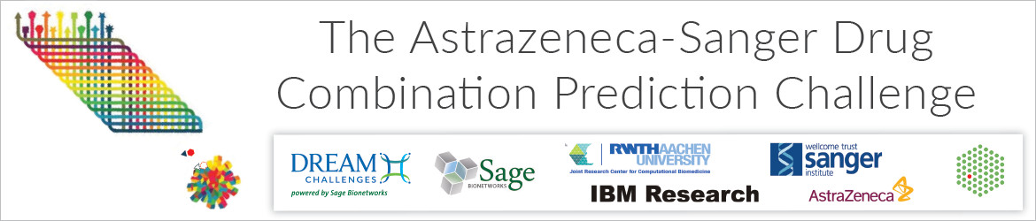
Future directions
~30k experimentally tested drug combinations measuring cell viability over 140 drugs and 120 cancer cell lines (primarily colon, lung, and breast), and monotherapy drug response data for each drug and cell line.
Genomic data including gene expression, somatic mutation, copy-number alterations, and methylation data.

Slide 61

Profs vs. Gene3D
CATH annotations of structures in the PDB
Library of HMMs
CATH annotations for proteins in Uniprot
CATH A HMM
CATH A HMM
CATH A HMM
CATH A HMM
…
…
…

Slide 62
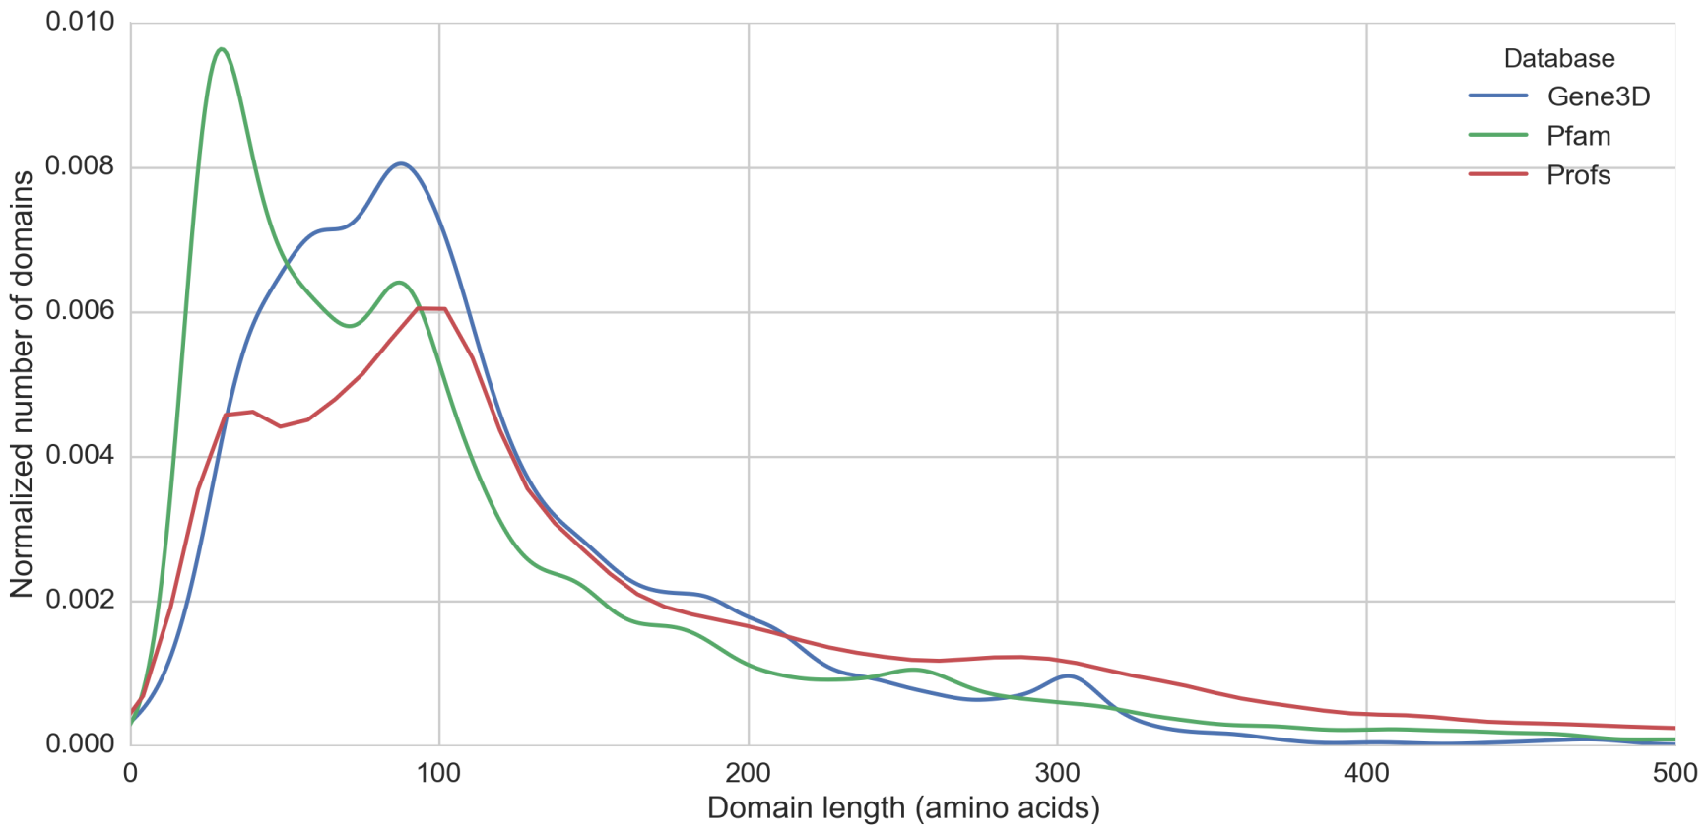
Profs vs. Gene3D: domain length
e.g.
A
B

Slide 63
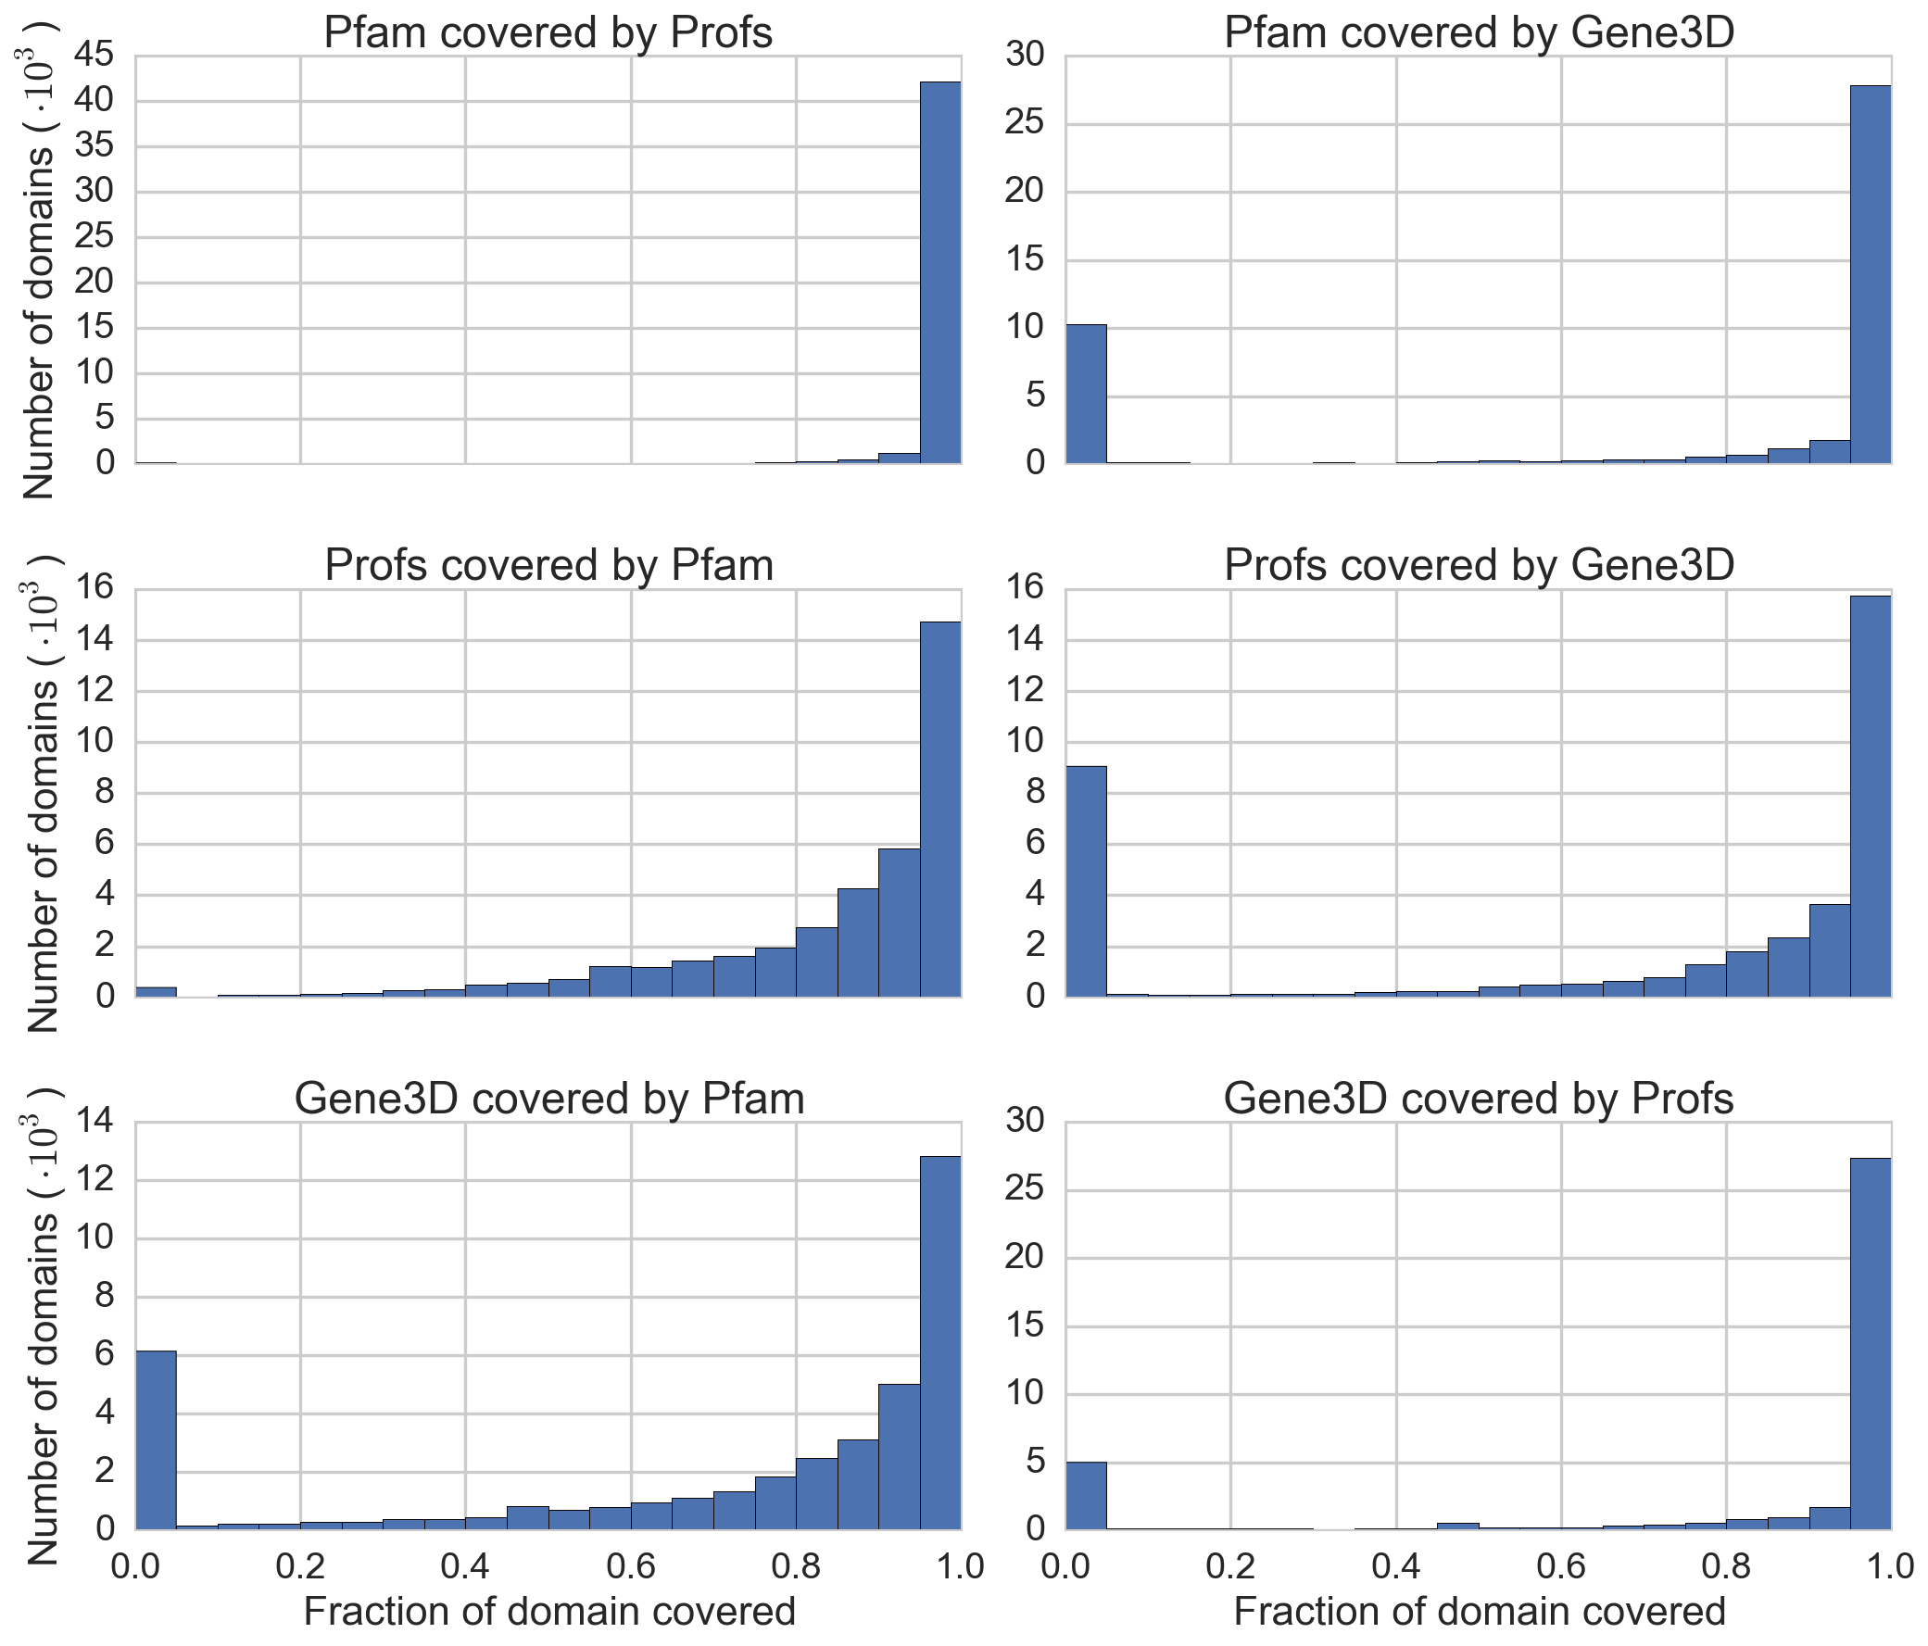
Profs vs. Gene3D: domain coverage
A
B
A
B

Slide 64
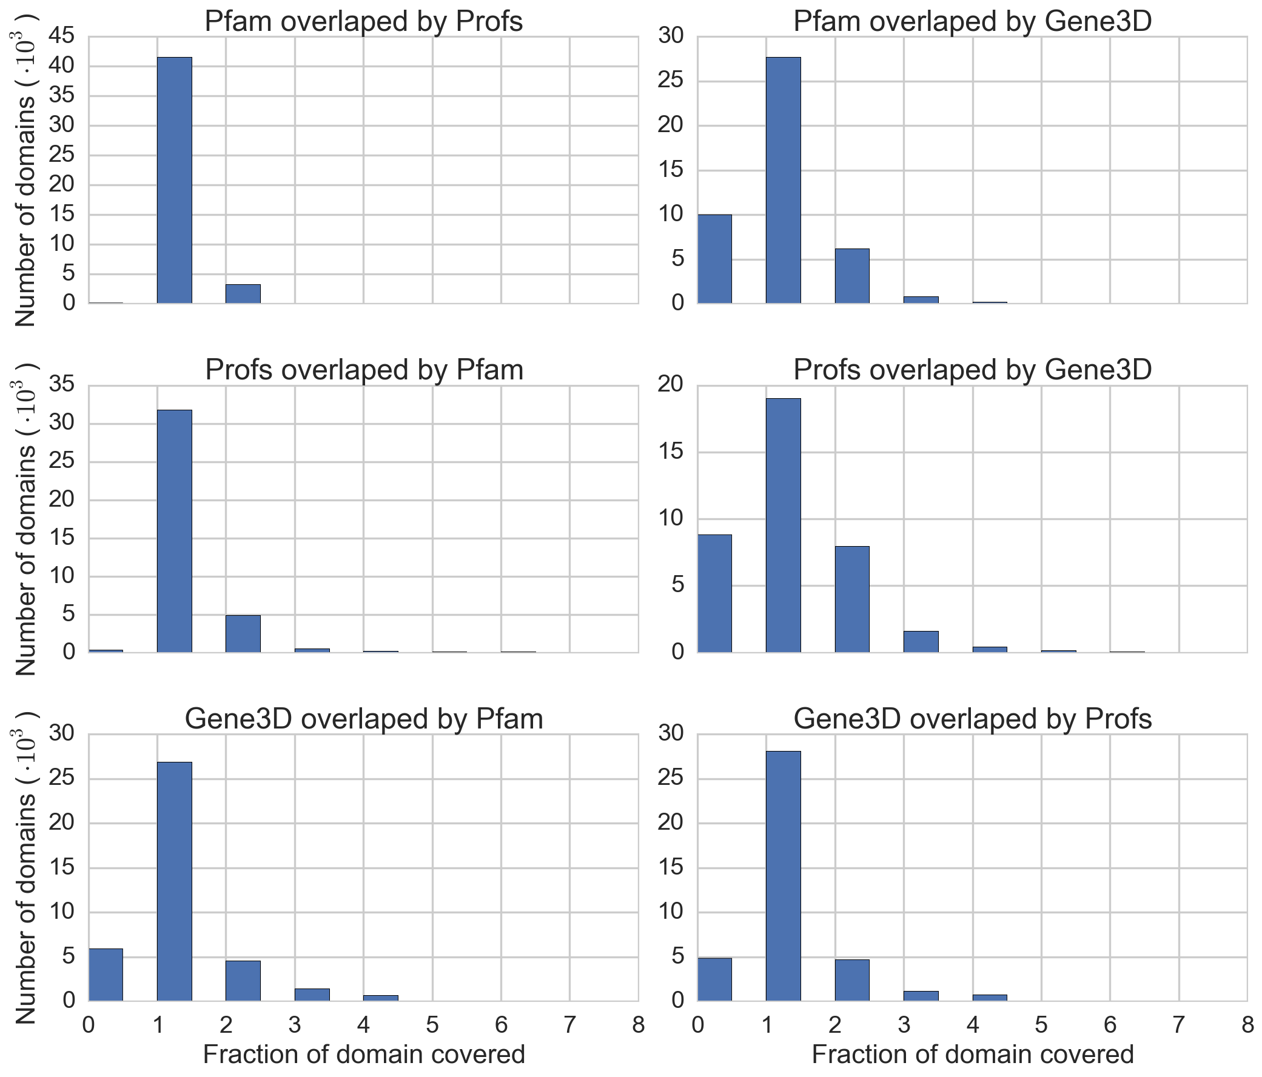
Profs vs. Gene3D: domain overlap
A
B
A
B

Slide 65
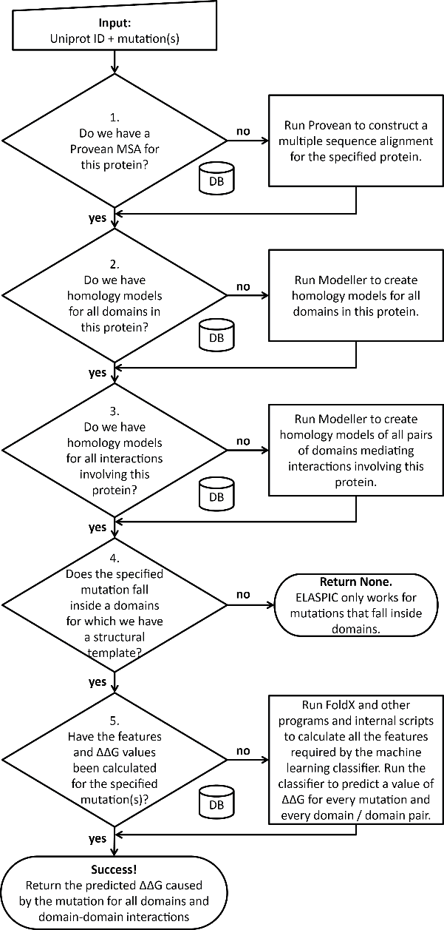

ELASPIC background

Slide 66
ELASPIC background

Slide 67
xxx

Slide 68
ELASPIC background

Slide 69
ELASPIC background

Slide 70
ELASPIC background

Slide 71
ELASPIC background

Slide 72
ELASPIC background

Slide 73


( )

Slide 74
Progress pre-calculating alignments and models
Provean
supporting sets
Uniprot domains
(human)
Uniprot domain pairs
(human)

Slide 75
Progress pre-calculating mutations
Provean
supporting sets
Uniprot domains
(human)
Uniprot domain pairs
(human)

Slide 77
Overview
ELASPIC background and progress
Alanine scanning of PPI interfaces
Correlation with disorderome peptide dropout scores
Validation of ELASPIC results using histone interaction data
Future directions

Slide 78
Results from

Slide 80
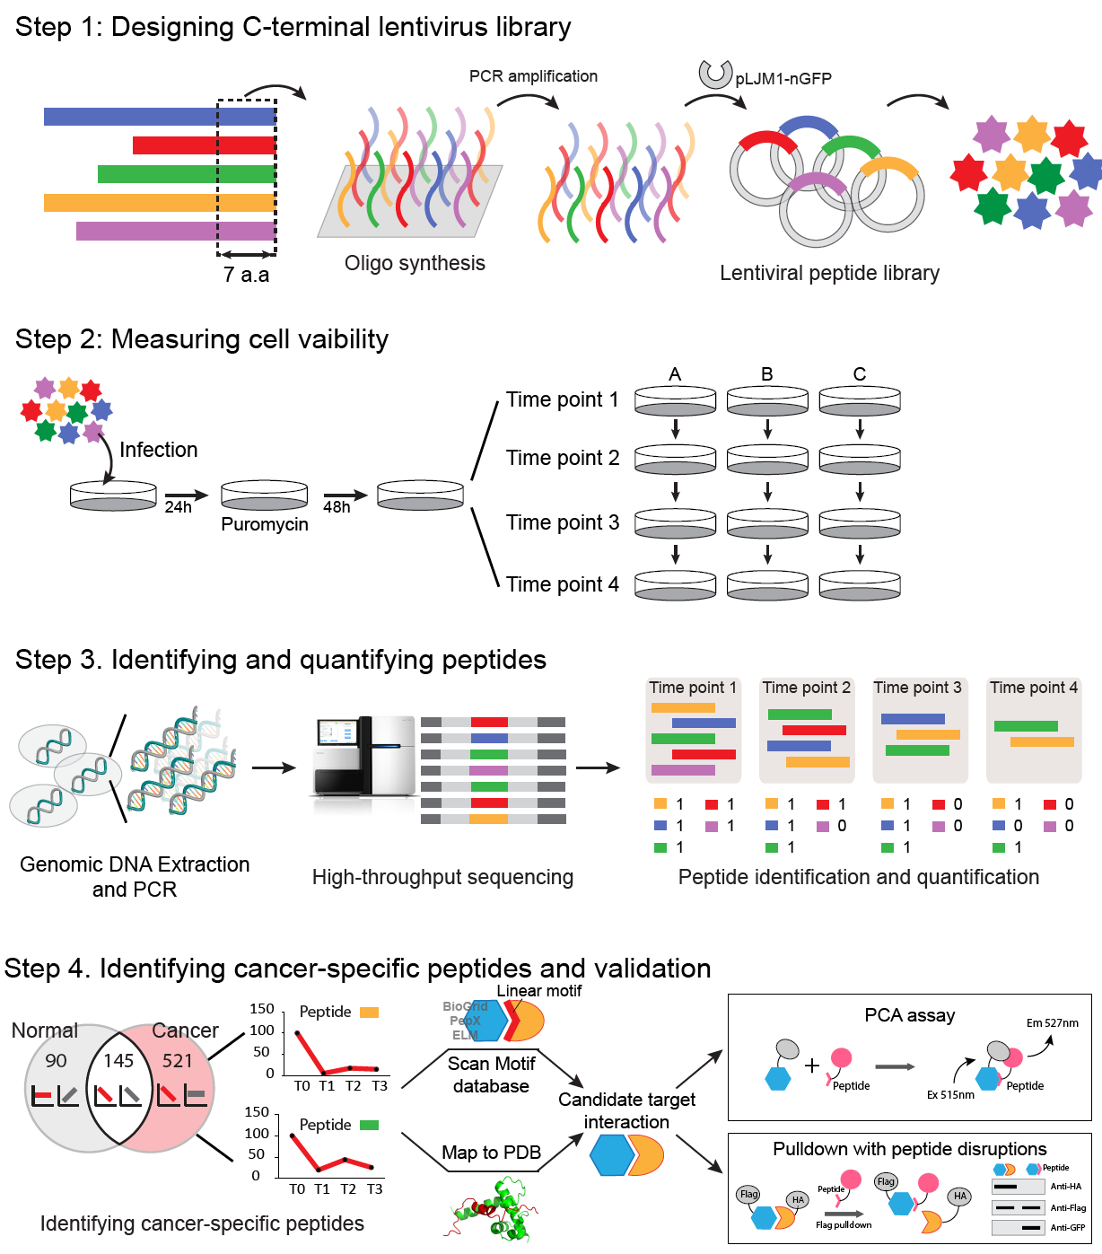
Identifying anti-proliferative peptides
By Satra Nim & Juhyun Clare Jeon

Slide 81

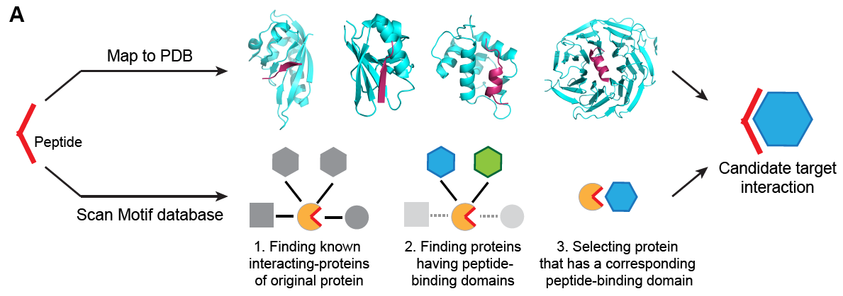

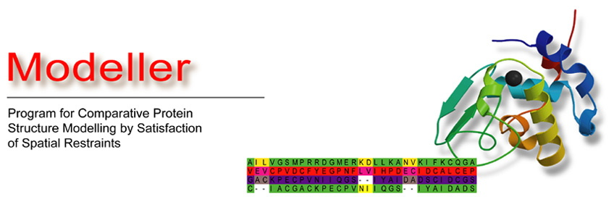
Mapping anti-proliferative peptides to structures
Potential Pairs
Target-Peptide
9,944
Map to DDI
models
+
PSIBLAST
+
HIPPIE
By Carles Corbi

Slide 82
Examples of models with disorderome peptides

Slide 83
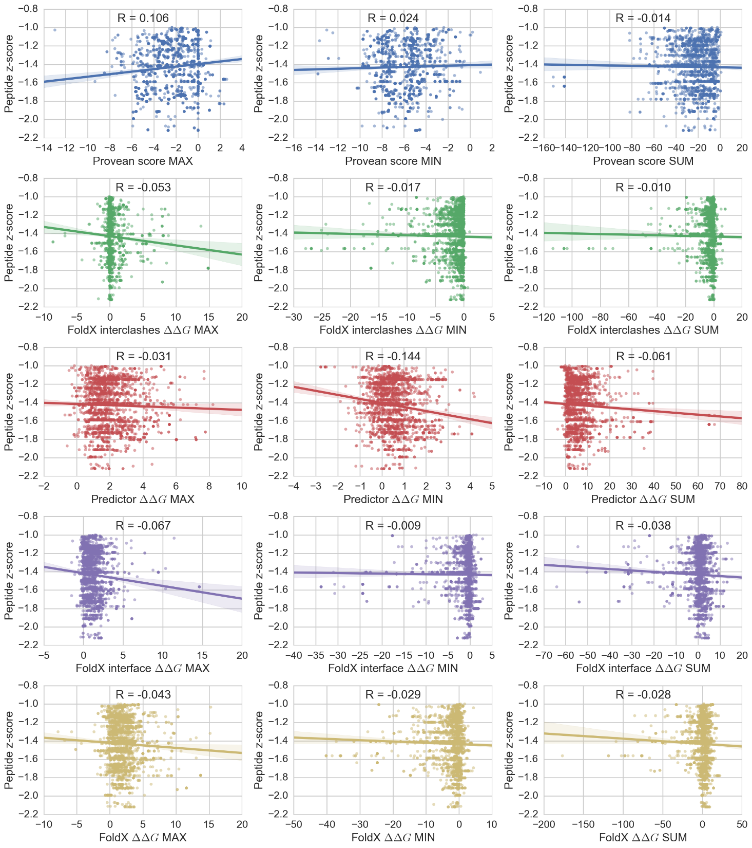
Correlation between features and dropout z-score

Slide 84
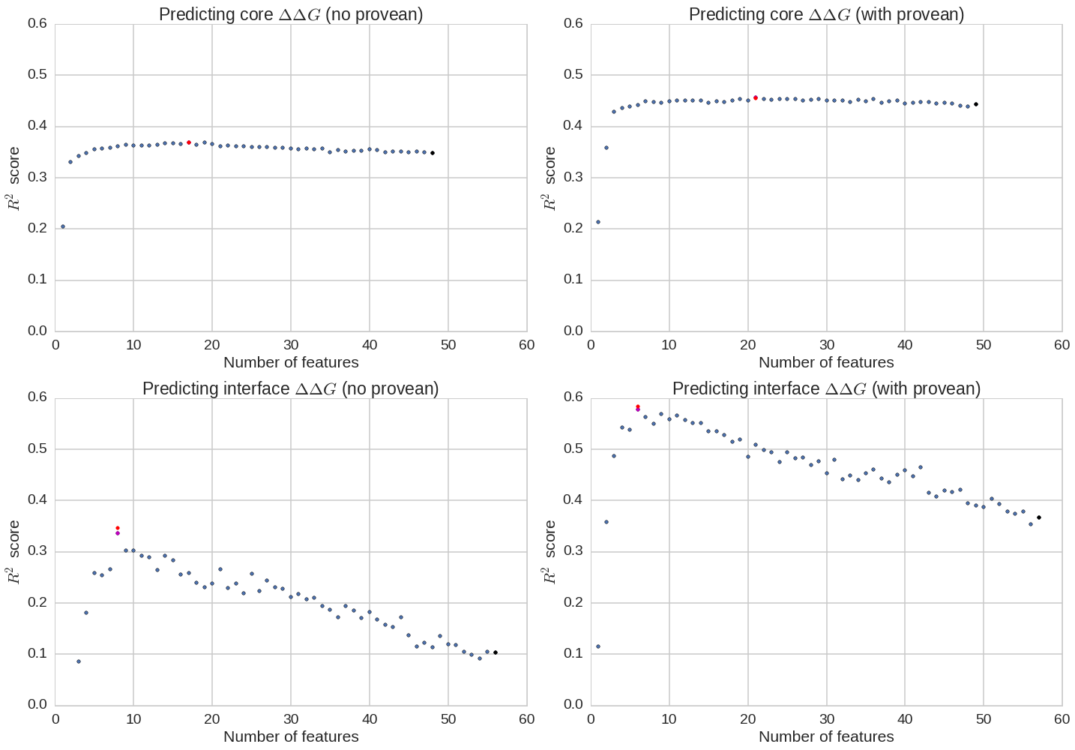
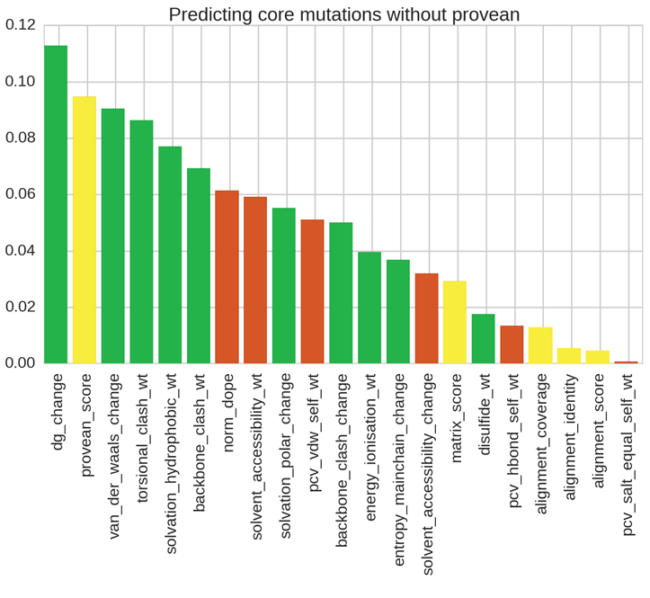
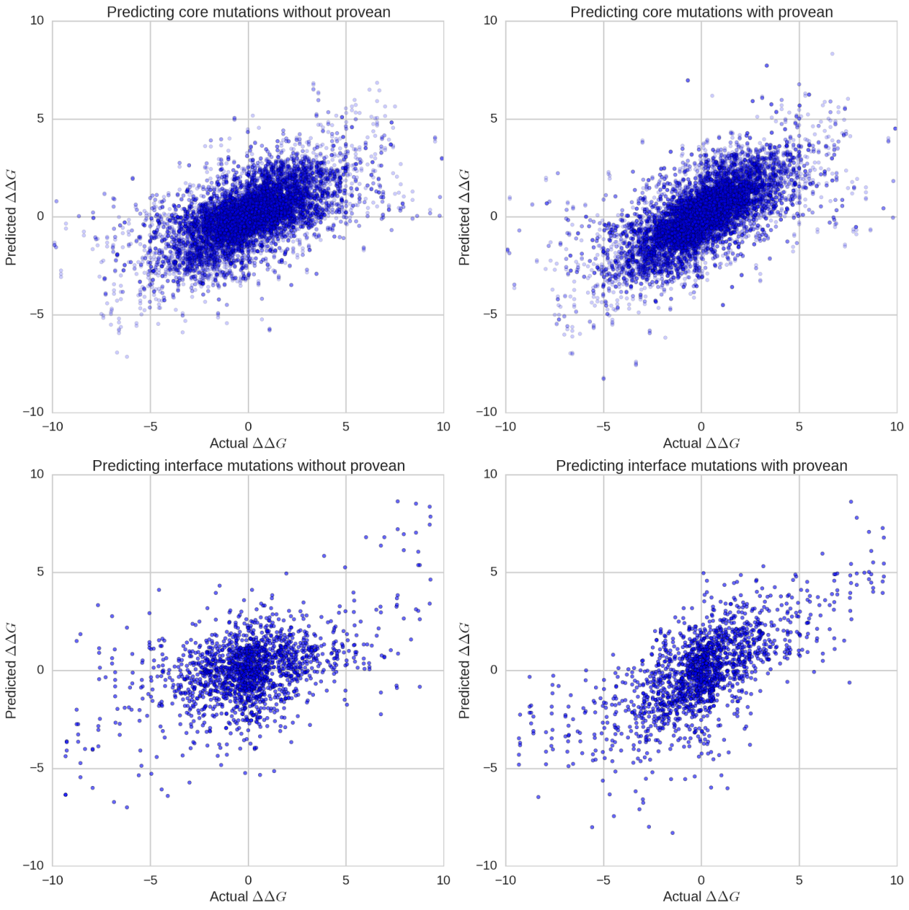
Predicting the effect of CORE mutations
R² = 0.46

Slide 85
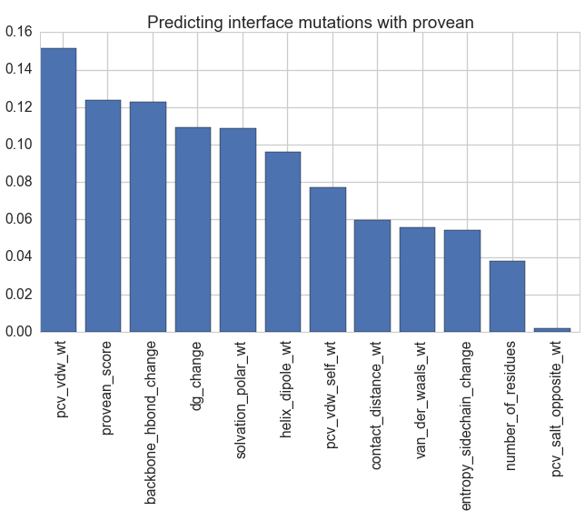
Predicting the effect of INTERFACE mutations
R² = 0.55

Slide 86
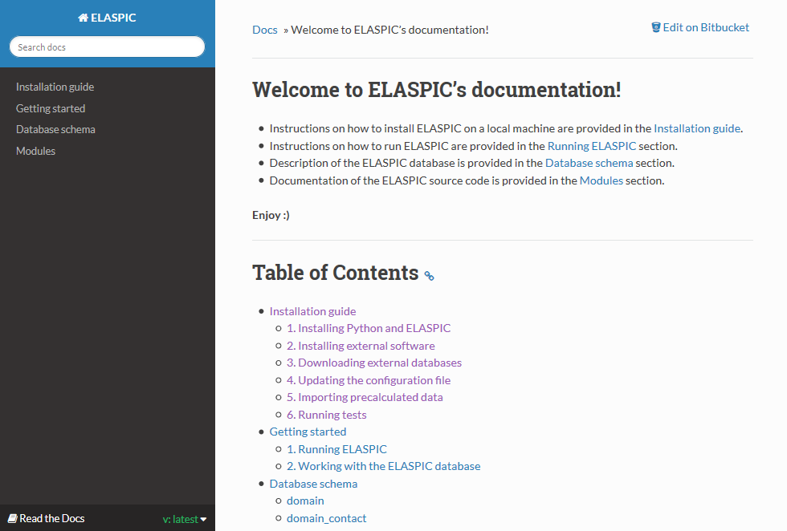
ELASPIC documentation

Slide 87

Predicting the thermodynamic effect of mutations
Correct domain boundaries:
PDBFam
ELASPIC pipeline
For every domain in every Uniprot:
Find a structural template for every PDBfam domain in Uniprot
Filter the PPI network, keeping interactions for which a domain-domain contact structure is available
Create homology models for single domains or domain-domain pairs
Compile a list of biophysical and biochemical properties (for each mutation)
Predict the ∆∆G of the mutation
∆G of domain
Mutation ∆∆G of domain folding
PPI network:
Hippie
∆G of protein interaction
Domain structures:
PDB / PDBfam
Mutation ∆∆G of protein interaction
Domain contact structures:
SCOWLP / PDBFam
- Tissue-specific PPI networks (splicing and expression levels)
- Protein function and phenotypic effect of mutations
interactome3d.irbbarcelona.org

Slide 88
Core
Uniprot Domain
Uniprot Domain
Template
Uniprot Domain
Model
Uniprot Domain
Mutation
Uniprot domain id
Uniprot accession
PDBfam name
PDBfam domain definition
Uniprot domain id
- Expanded domain definitions
- Pairwise sequence alignment filename
- Multiple sequence alignment filename
Uniprot domain id
- Model filename
- DOPE score
- dG of folding (FoldX)
Uniprot domain id
- Mutation
- Biophysical properties
- SASA score
- SIFT / PROVEAN score
…
∆∆G score
Profs domain template
Cath id
PDB id
PDB chain
PDB domain definition
PDBfam name
PDBfam clan
Interface (Protein-Protein)
Uniprot Domain Pair
Uniprot Domain
Pair Template
Uniprot Domain
Pair Model
Uniprot Domain
Pair Mutation
Uniprot domain pair id
Uniprot domain id 1
Uniprot domain id 2
Path to data
Type of interaction…
Uniprot domain pair id
- Expanded domain definitions
- Pairwise sequence alignment filenames
Uniprot domain pair id
- Model filename
- DOPE score
- Interface area
- Interacting residue
- dG of interaction (FoldX)
Uniprot domain pair id
- Mutation
- Biophysical properties
- SASA score
- SIFT / PROVEAN score
…
∆∆G score
PDBFam domain contacts
Domain contact id
Cath id 1
PDB contacting residues 1
Cath id 2
PDB contacting residues 2

Slide 89
Core
Uniprot Domain
Uniprot Domain
Template
Uniprot Domain
Model
Uniprot Domain
Mutation
Uniprot domain id
Uniprot accession
PDBfam name
PDBfam domain definition
Uniprot domain id
- Expanded domain definitions
- Pairwise sequence alignment filename
- Multiple sequence alignment filename
Uniprot domain id
- Model filename
- DOPE score
- dG of folding (FoldX)
Uniprot domain id
- Mutation
- Biophysical properties
- SASA score
- SIFT / PROVEAN score
…
∆∆G score
Profs domain template
Cath id
PDB id
PDB chain
PDB domain definition
PDBfam name
PDBfam clan
Interface (Protein-Protein)
Uniprot Domain Pair
Uniprot Domain
Pair Template
Uniprot Domain
Pair Model
Uniprot Domain
Pair Mutation
Uniprot domain pair id
Uniprot domain id 1
Uniprot domain id 2
Path to data
Type of interaction…
Uniprot domain pair id
- Expanded domain definitions
- Pairwise sequence alignment filenames
Uniprot domain pair id
- Model filename
- DOPE score
- Interface area
- Interacting residue
- dG of interaction (FoldX)
Uniprot domain pair id
- Mutation
- Biophysical properties
- SASA score
- SIFT / PROVEAN score
…
∆∆G score
Profs domain contacts
Domain contact id
Cath id 1
PDB contacting residues 1
Cath id 2
PDB contacting residues 2

Slide 90


Predicting the ddG of interface mutations
As a training set, we used the Skempi database, which contains ddG values for 862 interface mutations in crystallized protein complexes.
Leave-one-out cross-validation while excluding members of the same pfam family and clan from the training set results in a correlation coefficient of 0.37, mainly because most cross-validation bins have < 100 training points.
Naïve leave-one-out cross-validation results in a correlation coefficient of 0.74 .

Slide 91
Talk Overview
CSC2534 - Decision Making Under Uncertainty
Combining proteins and diseases in a probabilistic graphical network
ELASPIC
Using structural and functional features to predict the phenotypic consequence of mutations

Slide 92

Creating the core and interface training sets
Mapping mutations from Protherm / Skempi and from small-scale studies
Filtering out mutations that don’t fall inside domains
Making homology models of different sequence identities
Reversing the mutation and running the pipeline for mut -> wt
Parsing core mutations

Slide 93

Training the core and interface classifiers
Perform grid-search to find the best hyperparameters using all features
Perform recursive feature elimination to remove features that are not important
Perform grid-search again to find the best hyperparameters when using the final set of features
Train the final classifiers

Slide 94

Recursive feature elimination
Provean No reverse mutations
No Provean
Reverse mutations
Core mutations
Interface mutations

Slide 95

Cross-validation before feature elimination
Provean No reverse mutations
No Provean
Reverse mutations
R² ≈ 0.44
R² ≈ 0.35
Core mutations
R² ≈ 0.37
R² ≈ 0.11
Interface mutations

Slide 96



Cross-validation after feature elimination
Provean No reverse mutations
No Provean
Reverse mutations
R² ≈ 0.45
R² ≈ 0.37
Core mutations
R² ≈ 0.58
R² ≈ 0.35
Interface mutations

Slide 97


Significant features for core mutations
Provean No reverse mutations
No Provean
Reverse mutations
Relative importance

Slide 98

Significant features for interface mutations
Provean No reverse mutations
No Provean
Reverse mutations
Relative importance

